Slide 1
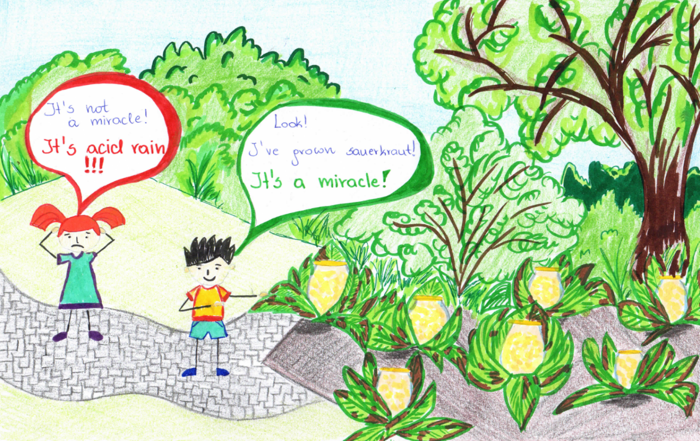
The Air Pollution
Maja Cecot, 8a

Slide 2
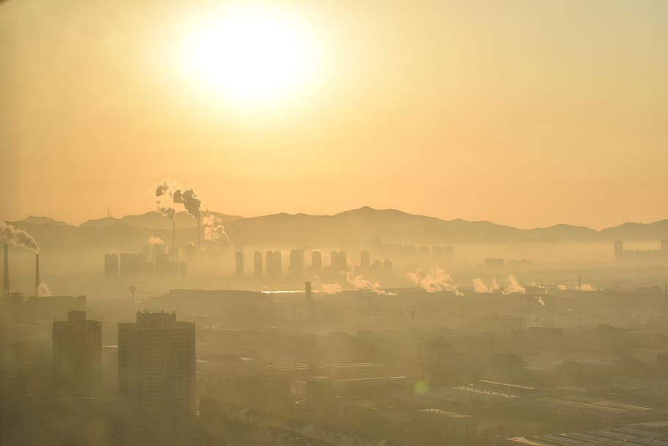
WHAT IS AIR POLLUTION?
the main cause of the global environmental threat;
Air contamination by substances that are harmful to health or dangerous for other reasons
the burning of fossil fuels, agricultural activities, and transportation are just some of the main causes of air pollution;
the most common and most polluting pollutants in the atmosphere: carbon dioxide, sulfur dioxide, nitrogen oxides and particulate matter.

Slide 3
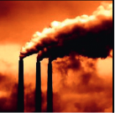
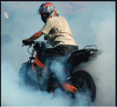
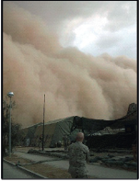
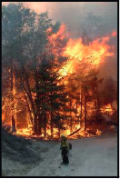
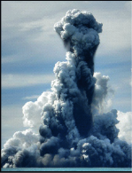
CAUSES OF AIR POLLUTION
Human activity
Naturals
liquid fuel combustion
volcano eruptions
solid fuel combustion
forest fires
household furnaces
sea salt aerosol emissions
industry
sandstorms
abrasion of road surfaces, tires
cars, brake pads and discs
(street dust)
wind erosion of soils and rocks
space dust

Slide 4
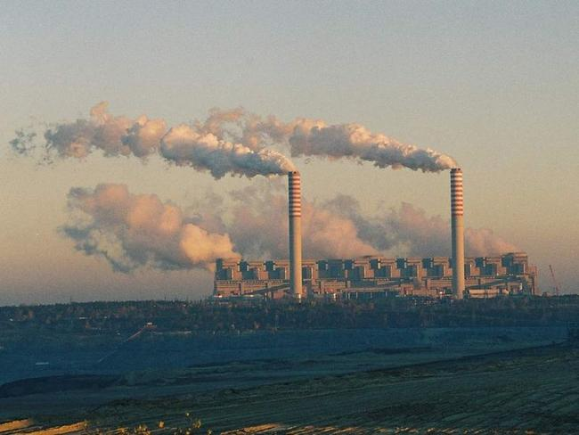
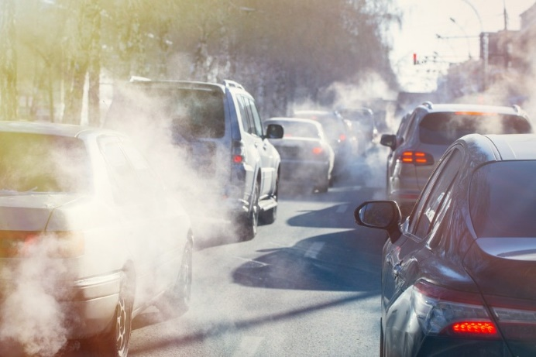
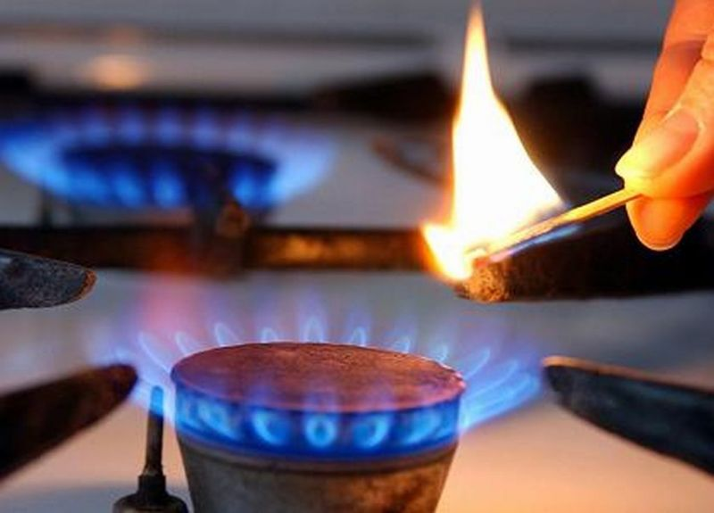
MAIN AIR POLLUTANT
SO₂
_{sulfur dioxide}
NO₂ and NO_{x}
nitrogen dioxide and nitrogen oxides
CO
_{carbon monoxide (chad)}
particulate matter PM 10
particulate matter PM 2,5
Benzo(a)pyrene

Slide 5
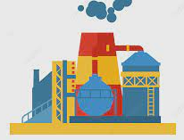
SOURCES OF AIR POLLUTION
IN THE EUROPEAN UNION
home heating
road freight
energy
industry
farming
other
PM₁₀
42 %
11 %
10 %
17 %
15 %
5 %
PM_{2,5}
57 %
11 %
12 %
10 %
4 %
6 %
NO_{X}
14 %
39 %
31 %
3 %
5 %
8 %
SO₂
13 %
78 %
7 %
2 %
IN TOTAL
32 %
15 %
48 %
5 %

Slide 6
SOURCES OF AIR POLLUTION
IN POLAND
home heating
road freight
energy
industry
farming
other
PM₁₀
62 %
6 %
14 %
18 %
PM_{2,5}
82 %
6 %
9 %
3 %
NO_{X}
7 %
44 %
32 %
17 %
SO₂
38 %
62 %
IN TOTAL
47 %
14 %
29 %
10 %

Slide 7
SOURCES OF AIR POLLUTION
IN SILESIA
home heating
road freight
energy
industry
farming
other
PM₁₀
69 %
6 %
20 %
5 %
PM_{2,5}
81 %
5 %
13 %
1 %
NO_{X}
8 %
40 %
47 %
5 %
SO₂
27 %
73 %
IN TOTAL
46 %
13 %
38 %
3 %

Slide 8
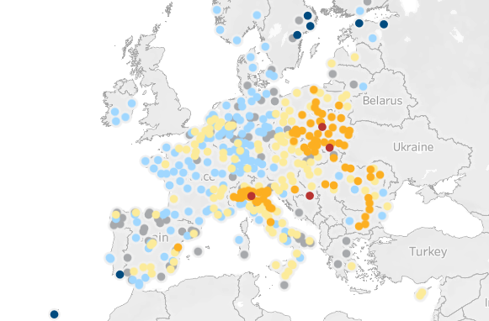
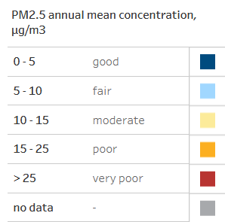
Air in European cities – from the cleanest to the most polluted

Slide 9
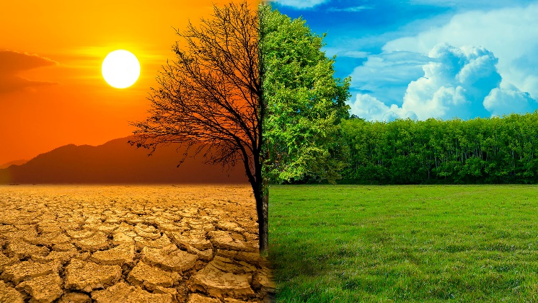
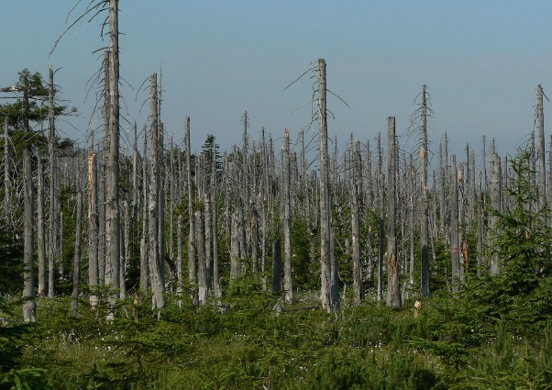
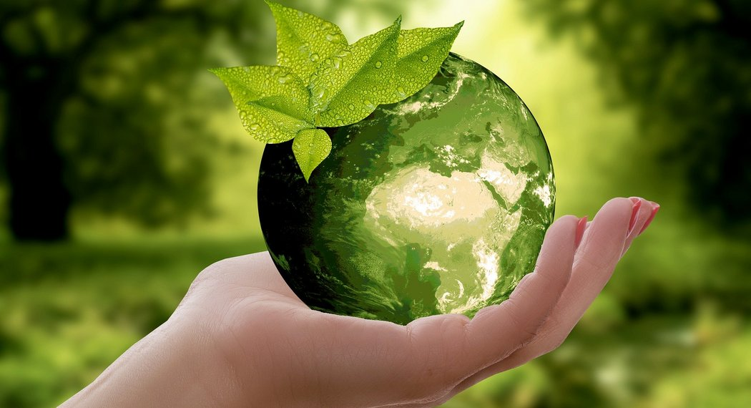
CONSEQUENCES OF AIR POLLUTION
global effects
cross border effects
local effects
greenhouse effect
smog
ozone hole
reduction in biodiversity
animal and plant diseases
acid rain
acidification of soils and waters

Slide 10
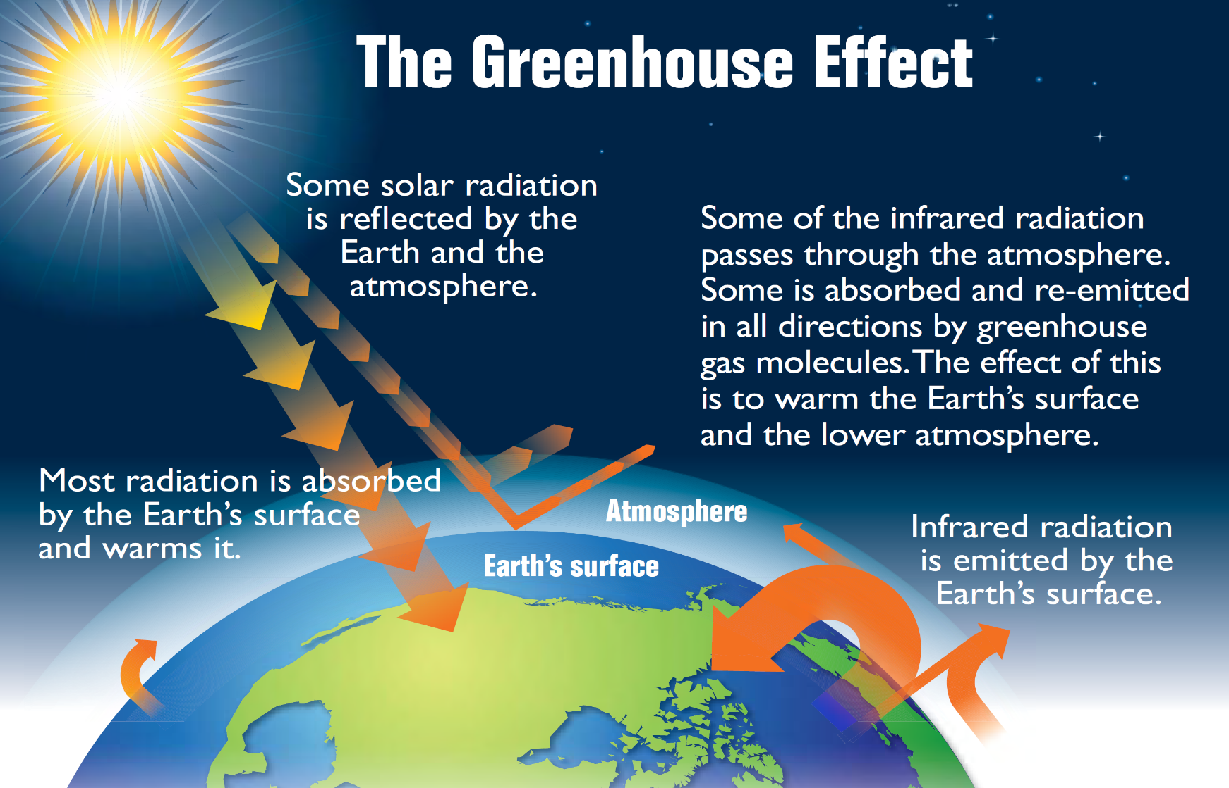
Climate change due to the increasing temperature of the Earth;
Increasing of greenhouse gases in the atmosphere due to fuel burning, tropical deforestation, chemical manufacturing processes;
In 2019. Earth was warmer by about 1.5°C compared to the end of the 19th century. - and the average global temperature is expected to rise even more over the next century.

Slide 11
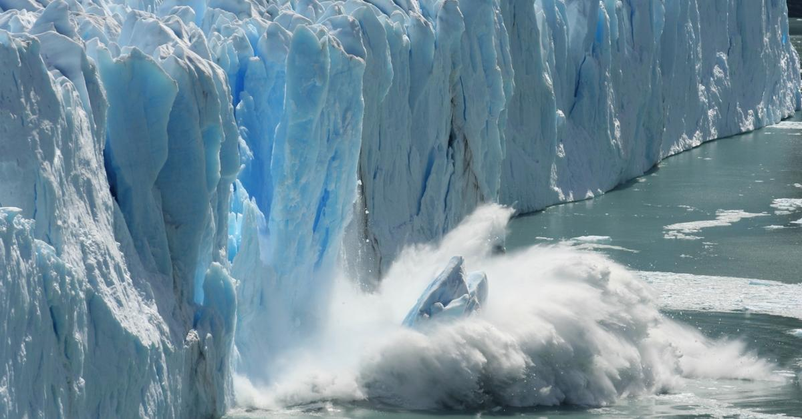
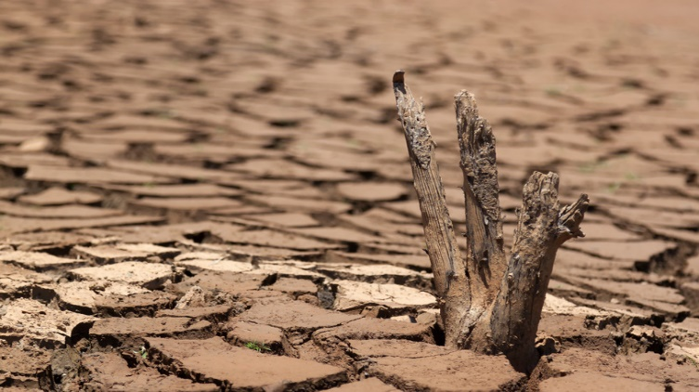
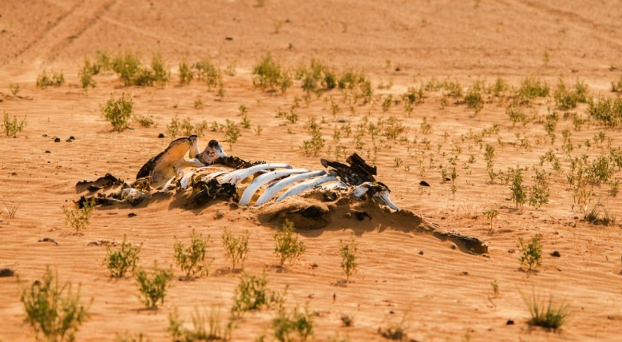
Effects of global warming
melting of glaciers,
frequent flooding in areas located close to seas and oceans and avalanches in the mountains,
Temperature increase across the planet - by an average of 0.2 degrees per decade,
extermination of many species of animals and plants,
Increased evaporation of water and more severe droughts, which cause the exhaustion of fertile areas of the Earth,
significant problems in agriculture, animal husbandry and many other sectors.

Slide 12
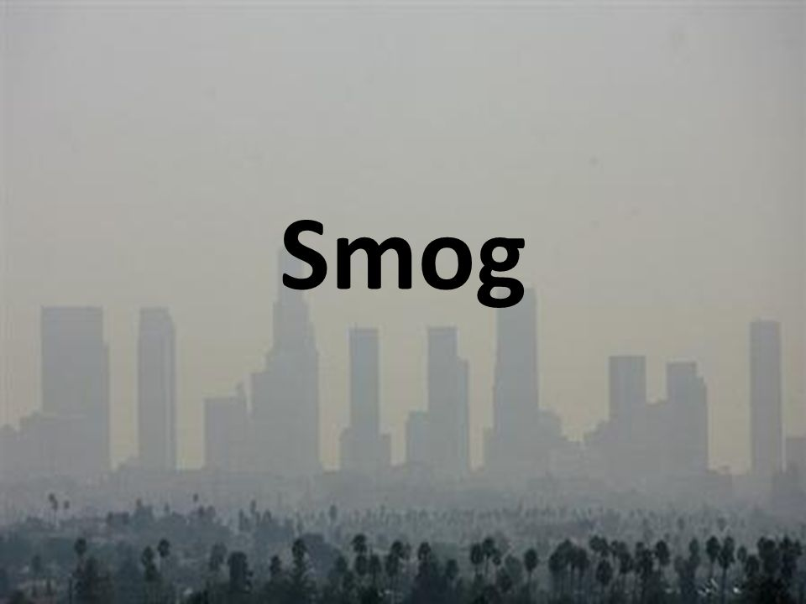
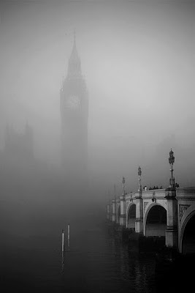
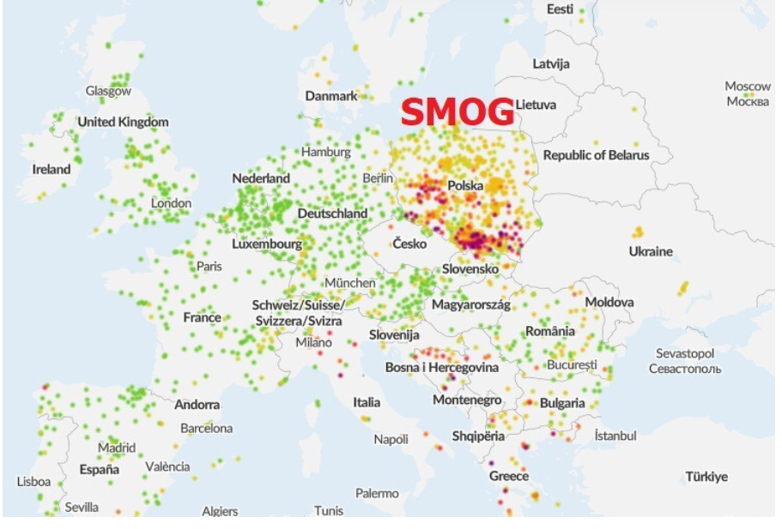
… atmospheric phenomenon resulting from the mixing of fog with smoke and fumes
… the main sources of smog are car exhaust, heavy industry and households (heating systems), combined with windless weather and high humidity, or fog
… is especially dangerous for babies, the elderly, asthmatics, people with respiratory and cardiovascular diseases
… nearly 19,000 Poles died from smog in 2016 in Poland
Air quality in Poland and Europe, December 19, 2020 8:00 pm
… in 1952, 12.000 people died in London due to smog

Slide 13
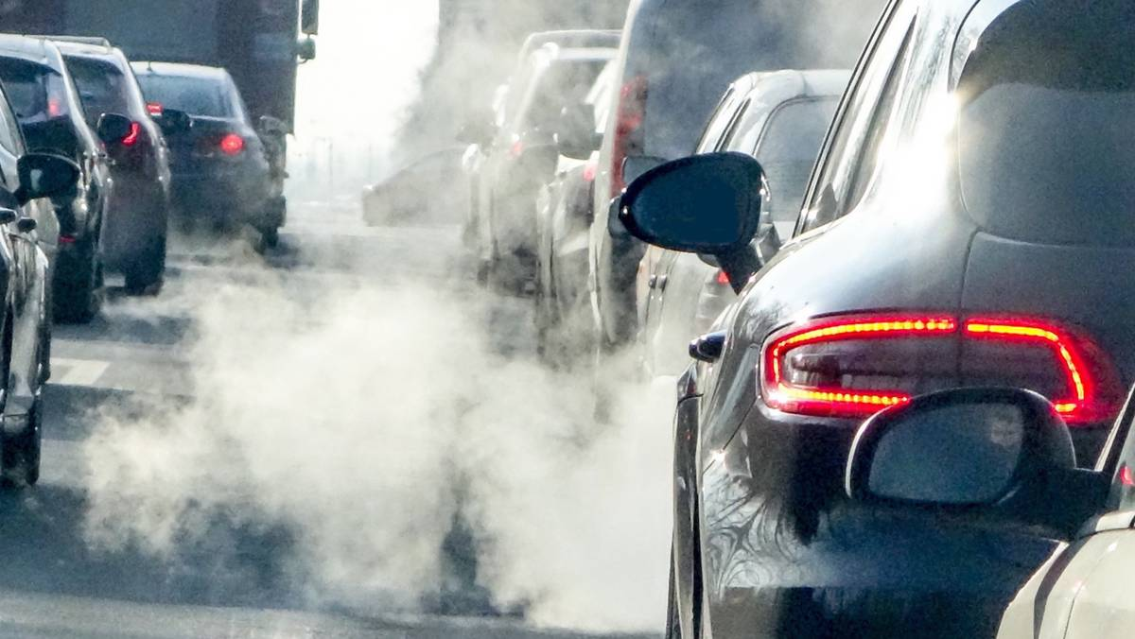
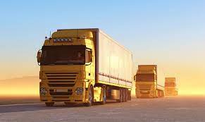
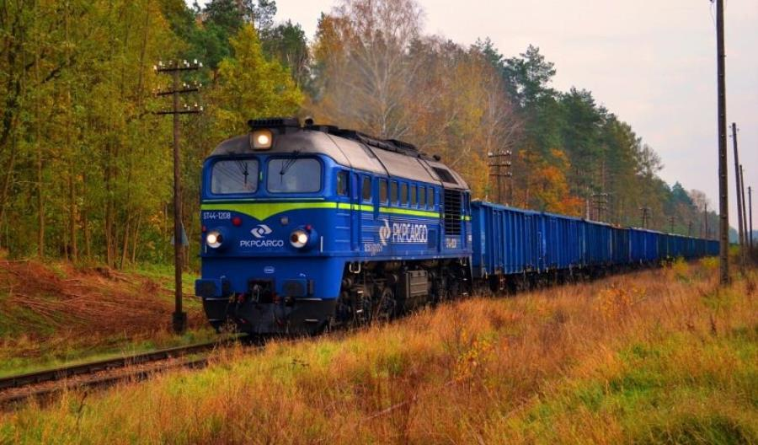
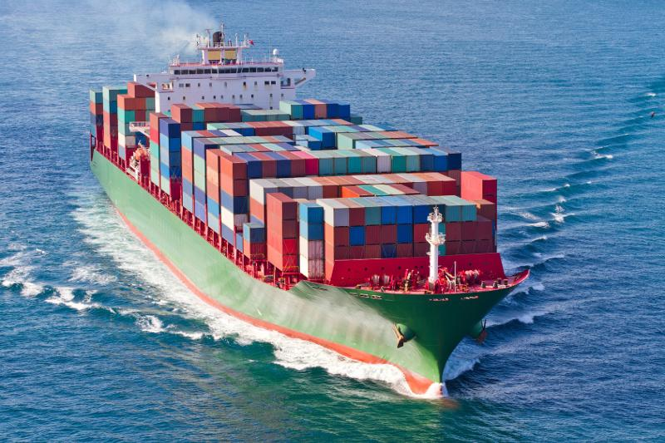
For humans, car exhaust is more harmful than pollution from industry because exhaust spreads in high concentrations at low altitudes in the immediate vicinity of people.
Vehicle exhaust is responsible for about 60-70% of the total cancer risk from carcinogenic air pollutants
The biggest environmental pollution is generated by road transport (72%), followed by maritime transport (14%), aviation (13%) and rail transport (0,4 %).
The European Green Deal aims to achieve a 90% reduction in transport-related greenhouse gas emissions by 2050. Reaching this milestone will involve significant changes in how we power and operate our cars, planes, and ships.

Slide 14
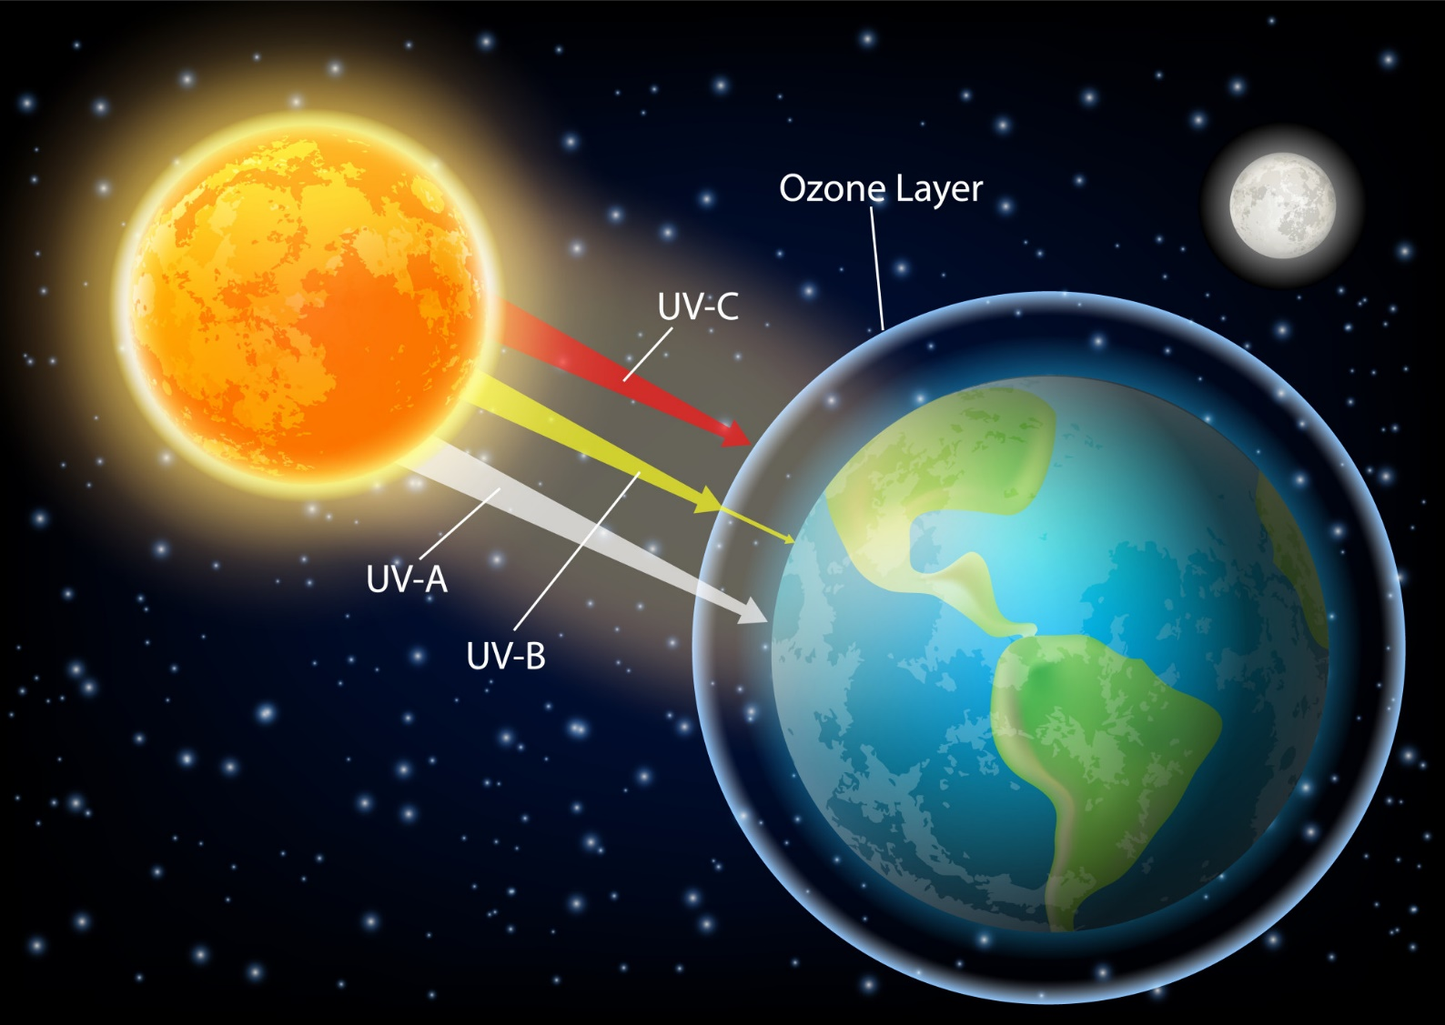
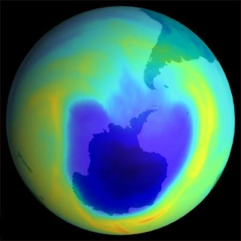
The
ozone hole
… reducing the amount of ozone in the Earth's stratosphere
… Ozone forms and decays when exposed to sunlight
… increased emissions of CFCs used in aerosol production
… the ozone hole has very serious consequences for life
… the ozone hole is the enemy of the whole Earth

Slide 15
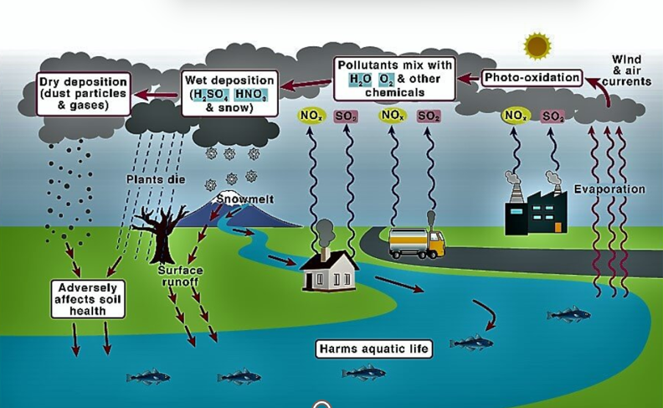
Acid rain
Acid rain is precipitation (not just rain, but also snow or fog) that contains large amounts of acids, most commonly sulfuric and nitric acids
Are mostly a direct consequence of human pollution of the environment.
In nature, rotting vegetation and erupting volcanoes release certain chemicals into the atmosphere that can cause acid rain.
However, the biggest sources of substances that form acid rain are air pollutants such as coal-fired power plants, factories and cars.

Slide 16
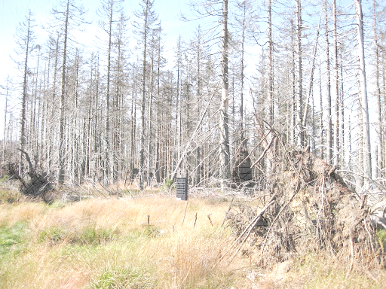
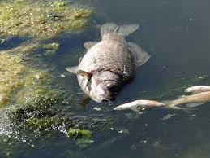
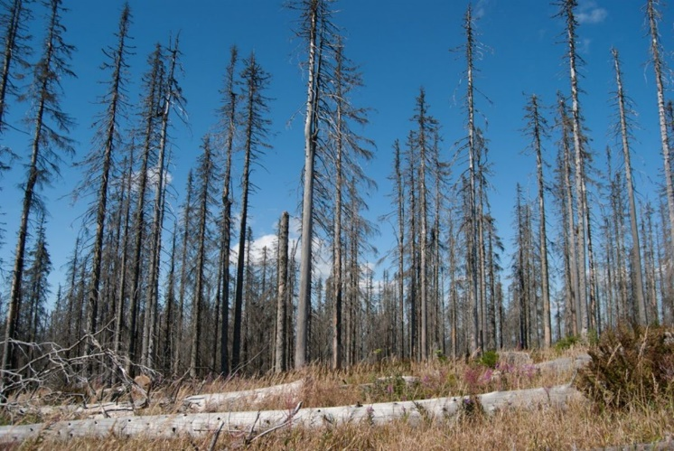
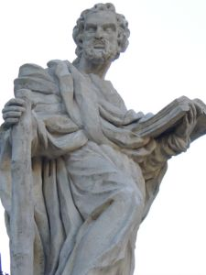
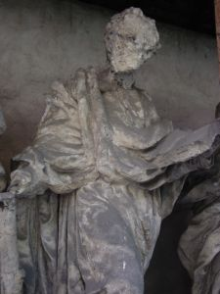
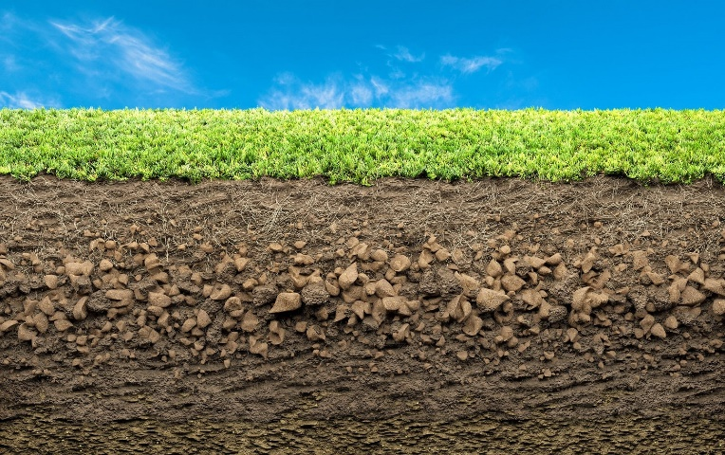
Effects of acid rain
acidification of surface waters
forest destruction
soil acidification
destruction of stone

Slide 17
REDUCTION IN BIODIVERSITY
Biodiversity is all the richness of the natural world
animals plants habitats genes
Man is the biggest threat to biodiversity
climate change
environmental pollution
disappearance of habitats and natural ecosystems
excessive exploitation of natural resources
introduction of invasive species into the environment

Slide 18
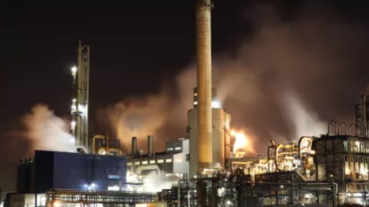
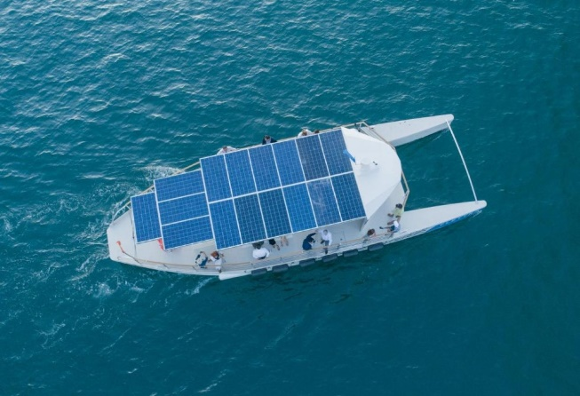
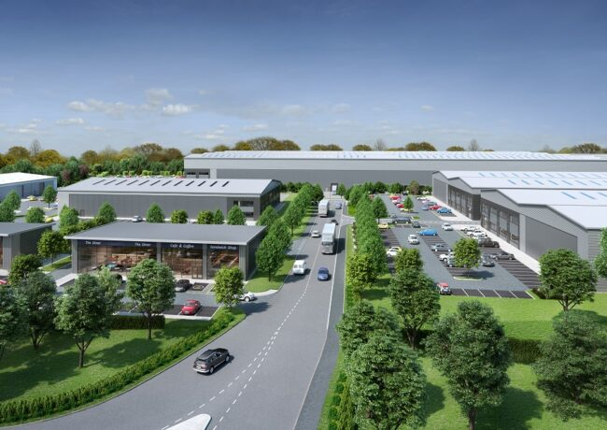
installing chimney filters
AIR POLLUTION PREVENTION
implementing new industrial technologies
Modification of old technologies
filters trap air pollutants
Investing in green modes of transportation and modification of the existing
new technologies are cleaner and less energy intensive
That is, desulfurization of coal before combustion, isolating production from the environment, change of fuel (e.g., natural gas instead of coal), building insulating
Building green belts around industrial plants
greenery traps some gaseous pollutants, especially dust
cars fitted with better catalytic converters, expansion of electric transport, promotion of bicycle transport

Slide 19
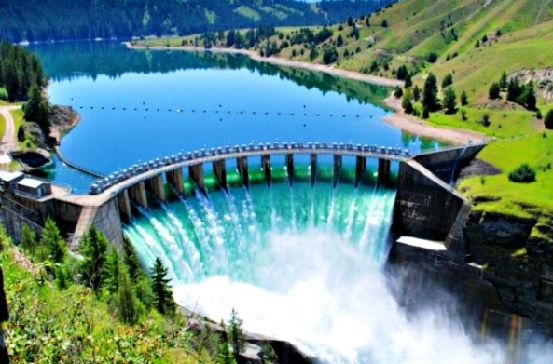
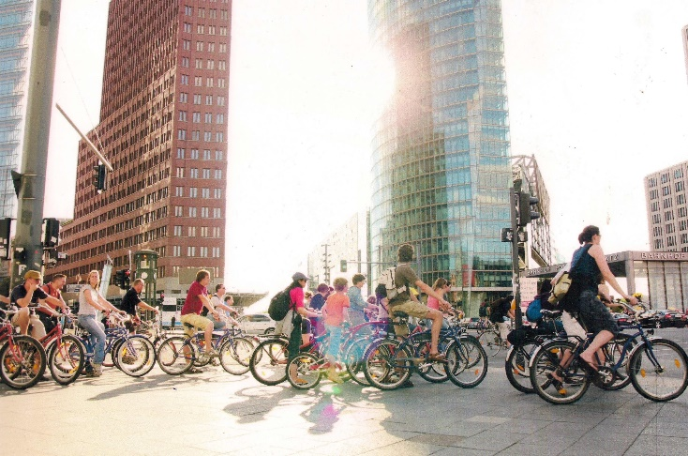
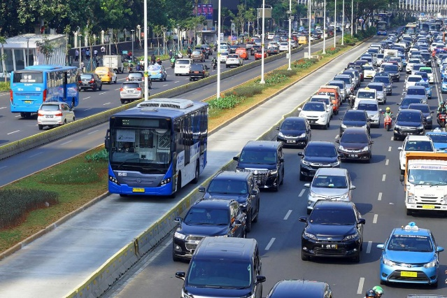
introduction of renewable sources of energy
solar energy
water energy
wind energy
creation of pedestrian zones in city centers and neighborhoods
elimination of heavy transport in cities
Reducing car traffic and changing transportation to electric vehicles
Encouraging public transport or cycling

Slide 20
Since the 1980s, the EU has adopted strict policies on air quality. The EU’s Ambient Air Quality Directives set air quality standards for 12 air pollutants. These directives also define common methods to monitor, assess and inform the public on ambient air quality in the EU.
To see where we are in relation to these goals, a network of more than 4.000 air quality monitoring stations creates reliable, objective, comparable information on air quality. When levels are above the limit or target values, Member States are expected to prepare an air quality plan or programme that addresses responsible sources and ensures compliance.
The Zero Pollution Action Plan also sets the 2030 target of improving air quality, with a focus on PM2.5, in order to reduce the number of premature deaths caused by air pollution in the EU by a minimum of 55%, relative to those in 2005.
On 12 May 2021, the European Commission adopted the EU Action Plan: "Towards a Zero Pollution for Air, Water and Soil" - a key deliverable of the European Green Deal.

Slide 21
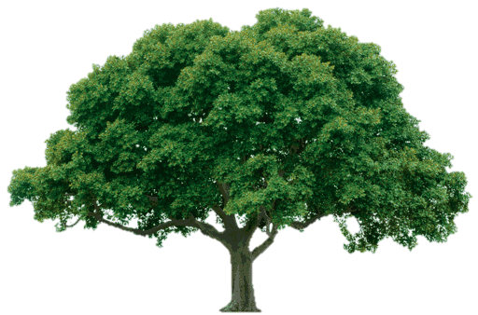
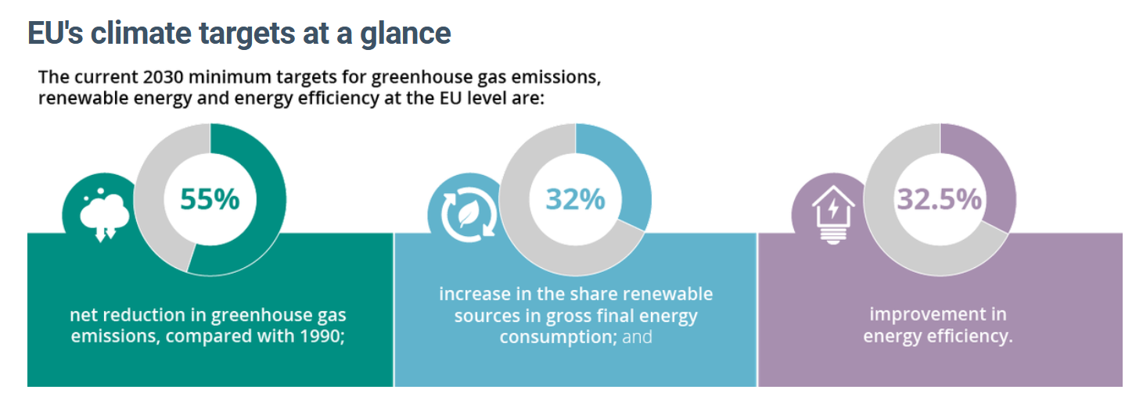

Slide 22
Activities for air protection in Poland
implementation of projects using renewable energy sources
construction of new or modernization of old heating systems
construction of charging stations and replacement of cars with electric vehicles by legal persons
thermal modernization of buildings
subsidies for photovoltaic installations
replacement of buses and emergency vehicles with hybrid or electric vehicles
installation of wind installations
implementation of programs to reduce dust and gas emissions
educational and promotional activities for clean air
implementation of projects of modern and effective technological systems as well as energy production, transmission and use systems

Slide 23
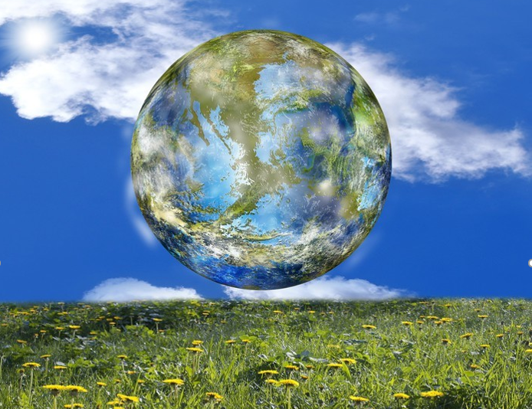
… remember, you are what you breathe …
We breathe from the moment we are born until the moment we die - it is a basic and constant need not only for each of us, but also for all living organisms.
Air quality has a huge impact on our health, our environment, our work activities, our entire lives.
And you? How do you take care of the air?

Slide 24
Thank you for your attention
https://op.europa.eu/webpub/eca/special-reports/air-quality-23-2018/pl/#A11
https://powietrze.gios.gov.pl/pjp/rwms/content/show/6762
https://energyeducation.ca/encyclopedia/Greenhouse_effect
file:///C:/Users/sebas/Downloads/OR_2020%20RWMS%20Katowice%2028.04.2021_fin.pdf
https://www.eea.europa.eu/themes/air/urban-air-quality/european-city-air-quality-viewer
https://filtryplus.pl/2023/01/25/jakosc-powietrza-w-europie/
https://www.pie.pl/aktualnosci/materialy-pokonferencyjne-praktyczne-wyzwania-na-rzecz-ochrony-powietrza/

