Slide 1
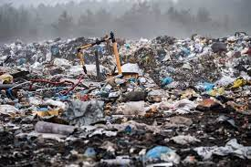
WASTES
All you need to know

Slide 2
Trash
Michał Chyliński VII A

Slide 3
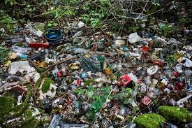
Trash around the world.
Did you know that the European Union produces around 225 million tons of waste, that mankind produces about 2.4 billion tons of waste a year? If you know how much it really is, you know we have to do something about it. In this presentation, I want to present some basic facts about trash and how to get rid of it.

Slide 4
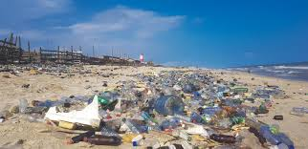
Facts about plastic.
Plastic was invented in 1907. Plastic is made from fossil fuels, which contributes to global warming. Plastic takes hundreds of years to break down. More than 40 percent of plastic is used just once before it is thrown away. Eco tip: Use alternative materials instead of plastic that are multi-use, for example glass cups or metal straws.

Slide 5
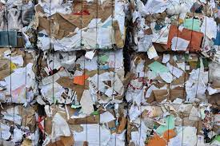
Facts about paper.
Paper packaging has a low climate impact. Paper packaging is recyclable and biodegradable. Paper packaging is Eco-Friendly. Many paper bags can withstand more pressure or weight than plastic bags. Eco tip: Always recycle paper packaging so we dont have to produce more paper, so we won’t have to cut down more trees.

Slide 6
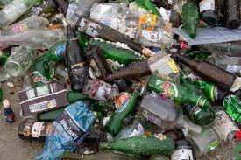
Facts about glass.
Glass can be recycled over and over again. There are glass like products that cant be recycled (light bulbs, mirrors). When you recycle one single glass bottle, you generate alot of energy. Glass is one of the most sustainable consumer materials. Eco tip: Dont throw away glass containers like bottles, wash them and reuse them.

Slide 7
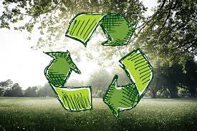
How to start recycling in your household.
Change your trash bin to one that has multiple waste compartments.
Use upcycling in your home (upcycling is the reuse of packaging, e.g., a cookie box).

Slide 8
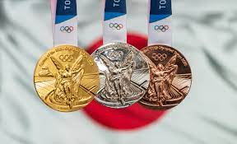
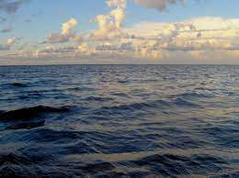
Fun facts about trash.
The gold, silver and bronze medals for the 2020 tokyo olympic games were made from recycled smart phones and other electronic equipment. The recycling campaign produced 32 kilograms of gold, 3492 kilograms of silver and 2200 kilograms of bronze. Fishing nets are the biggest contributor in terms of plastic sea pollution, contributing around 10% of the sea’s plastic.

Slide 9
Thank you for your attention!
Michał Chyliński VII A

