Slide 1
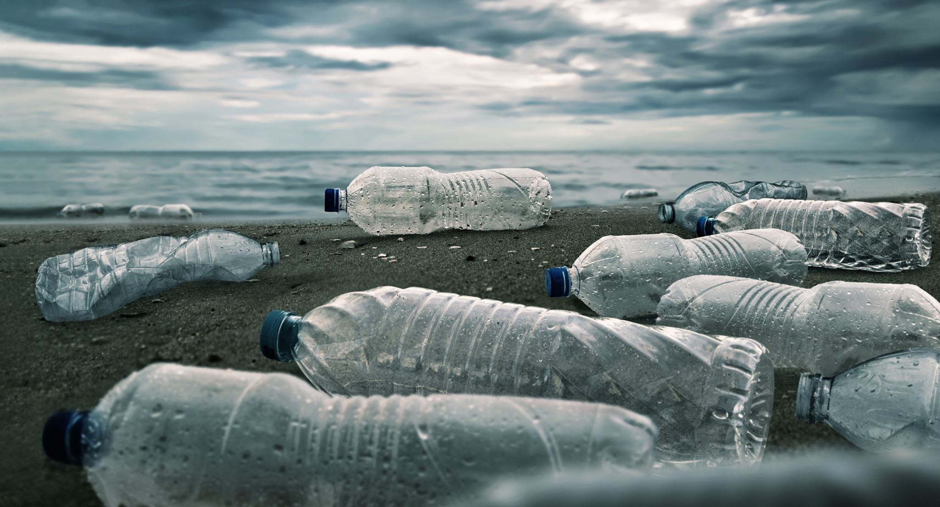
WASTE

Slide 2
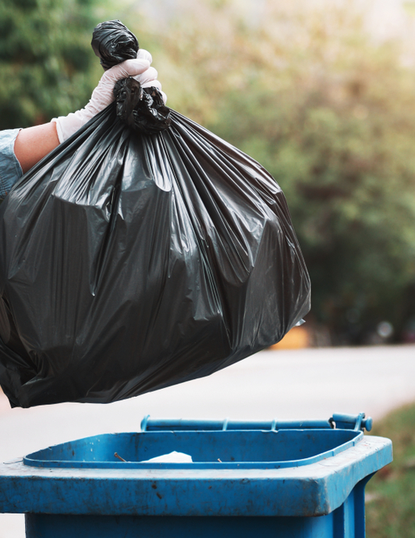
Do you know how much garbage a year does the average Pole produce?
-Research shows that the average European produces about 500 kg of garbage a year, and the amounts are constantly increasing.

Slide 3
What is the impact of garbage on the environment?

Slide 4
Harmful activities of waste - seas, oceans
One of the areas most vulnerable to pollution is water. Leachate is formed there, they are a combination of precipitation and putrefactive processes. They have a damaging effect on water both on the surface and below the surface, as they contain acids and heavy metals.
The life of aquatic animals is also a huge risk.

Slide 5
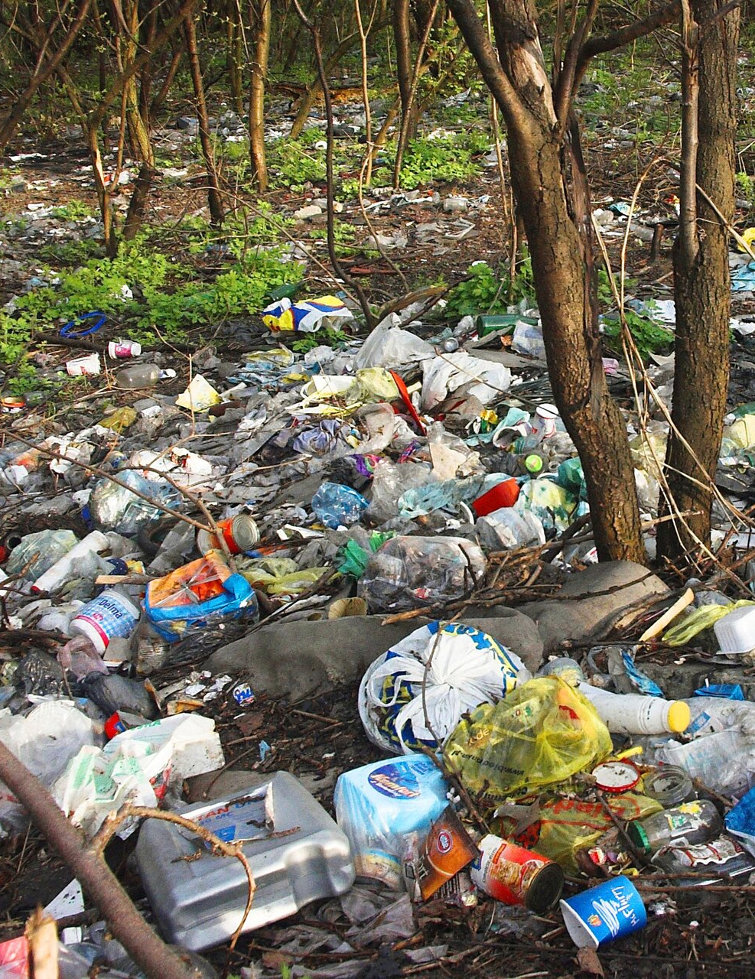
Harmful activities of waste-soil
Another segment is unprotected landfills that cause soil poisoning. Depending on the type of contamination, it can take a long time for soil to cleanse, but it can also be irreversible. Fortunately, there are fewer and fewer such illegal garbage dumps and we strive to prevent them from existing at all.

Slide 6
Harmful activities of waste - air
Another threatened area is air, the pollution of which results from the emission of poisonous gases and dust.
Contaminated air has negative consequences for humans and animals. Such a noticeable effect is, for example, an unpleasant odor coming from landfills, which increases with increasing temperature.

Slide 7
E-waste

Slide 8
What is e-waste?
E-waste (electronic waste) includes anything with plugs, cords and electronic components. Common sources of e-waste include televisions, computers, mobile phones and any type of home appliance, from air conditioners to children's toys.

Slide 9
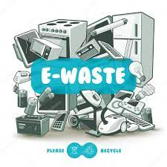
Why is e-waste a problem?
One of the world's largest producers of electronic waste is the United Kingdom. When broken or unwanted electronics are thrown in a landfill, toxic substances such as lead and mercury can find their way into soil and water.
Electronics also contain valuable non-renewable resources including gold, silver, copper, platinum, aluminium and cobalt. This means when we dispose of them without recycling, we are throwing away precious materials.

Slide 10
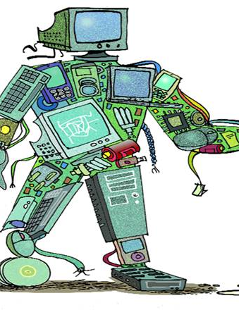
Today's e-waste recycling solutions only export the problem
Recycling is a preferable option to sending valuable componentry to landfill, but it comes with its own ethical considerations.
Processes are slow and inefficient.

Slide 11
How to recycle mobile phones, computers and other electronics?
1. Postpone upgrading for as long as you can,
2. Find opportunities for reuse,
3. Try returning the item to the manufacturer,
4. Take them to a dedicated e-waste recycling facility.

Slide 12
Sources
1-https://www.ecowatch.com/olympics-medals-recycled-smartphones-computers-2654414145.html
2-https://www.nhm.ac.uk/discover/what-is-ewaste-and-what-can-we-do-about-it.html
3-https://ekodrogeria.pl/blog/ile-smieci-rocznie-produkujemy

Slide 13
Thank you for your attention!
Paweł GIL
7a

