Slide 1
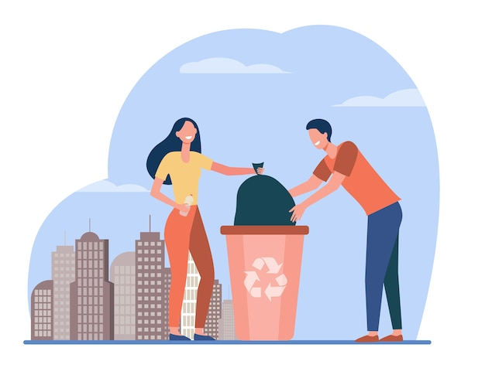

Slide 2
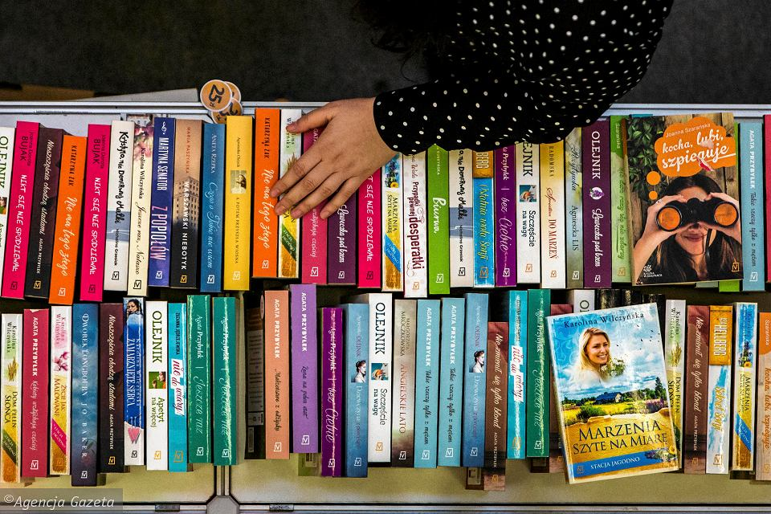
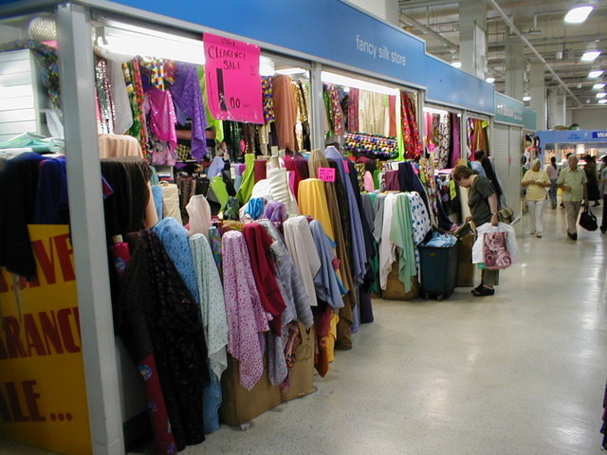
Let’s promote sharing things!
Magazines - read and give to your neighbors
Old clothes - when you don’t want them, you can give them to
Books - when you finish reading, bring the book to the library or find a shelf for sharing books in the local shopping centre
Others

Slide 3
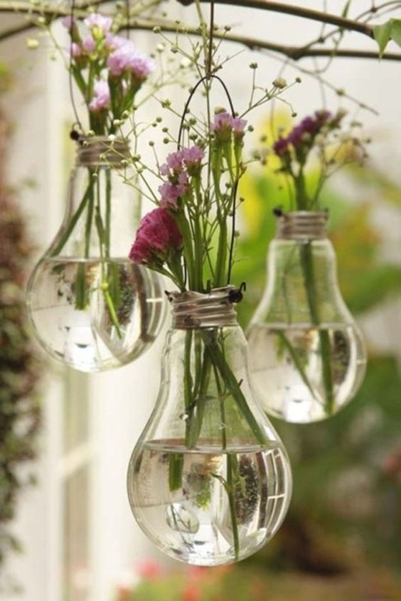
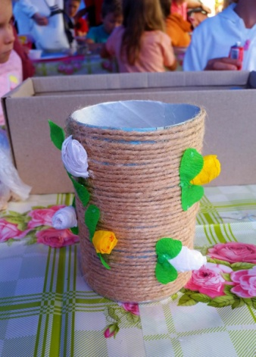
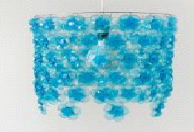
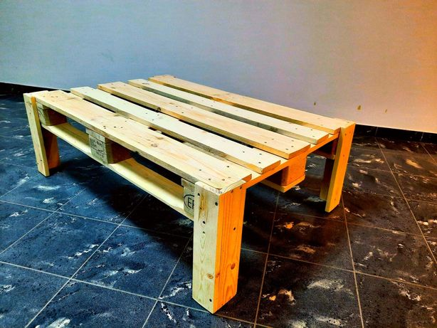
UPCYCLING you can make beautiful and useful new things out of waste!
For example - use an old wooden palette to make a lovely coffee table!
https://www.youtube.com/watch?v=dZZArMbFj3w

Slide 4
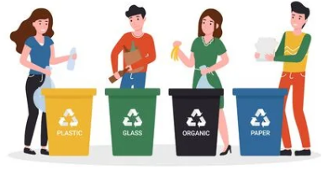
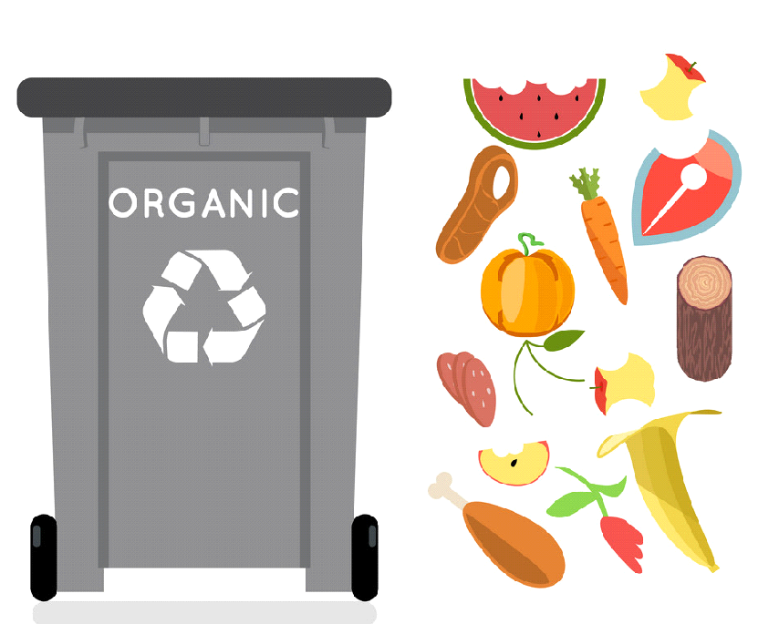
Household waste - sort it !

Slide 5
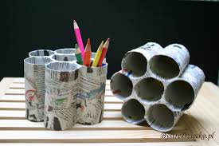
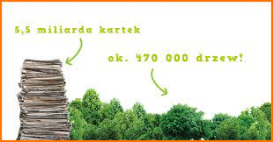
Paper – what can be done: recycled paper is the greenest option, it uses less energy, water, and produces lower carbon emissions than the manufacturing of non-recycled paper and at the same time reduces the amount of waste to landfill toilet paper, books, copybooks, straws
1 ton of paper = 17 trees.

Slide 6
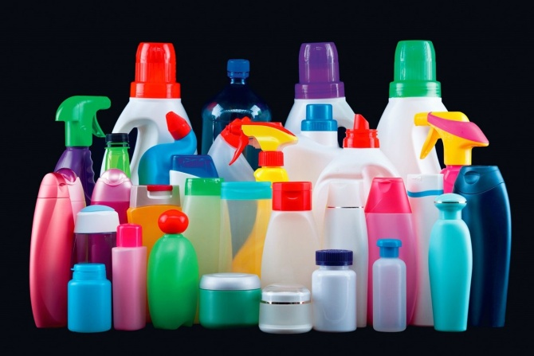
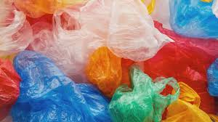
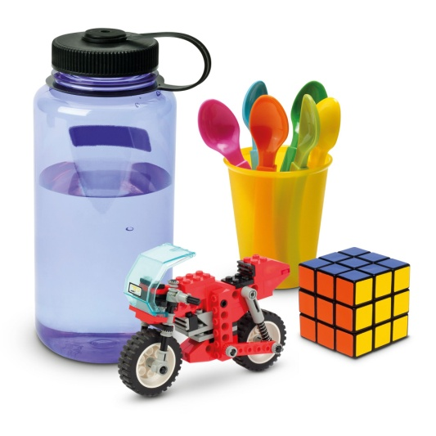
Plastic is one of the most popular and useful materials of modern times and it is important that we optimise the lifespan of plastics as much as possible. Worldwide we produce 300 million tonnes of plastic each year and most people are re-using and recycling their plastics.

Slide 7
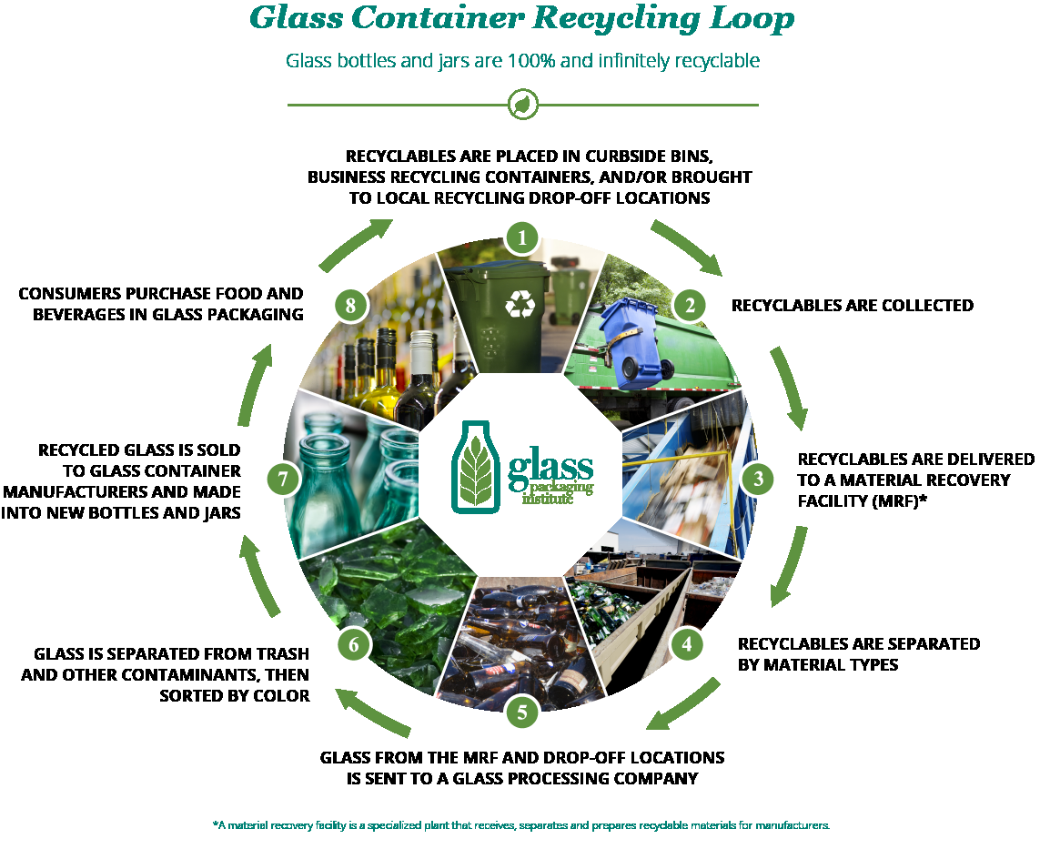
Glass is 100% recyclable and can be recycled endlessly without loss in quality or purity.

Slide 8
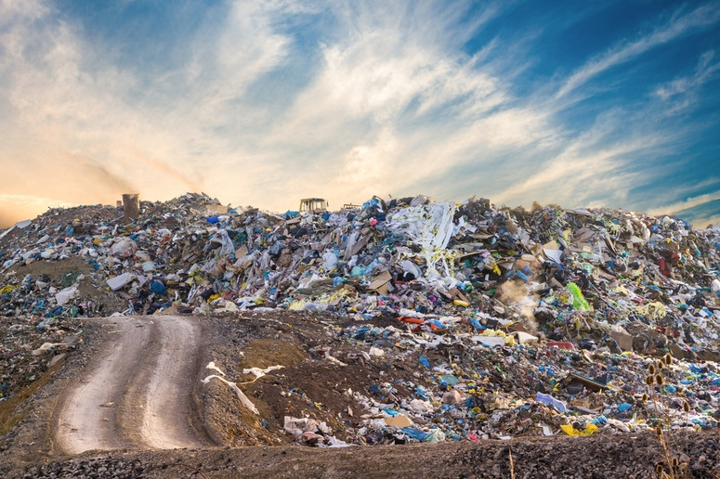
LANDFILL - THE MORE WASTE WE REUSE, THE LESS WASTE GOES TO LANDFILLS

Slide 9
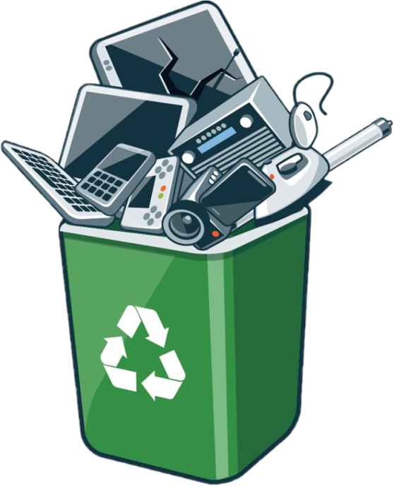
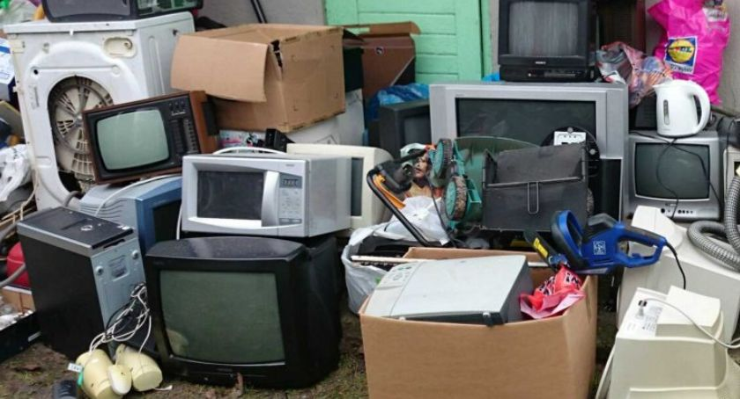
Electronic waste- Elestronics aslo contain valuable non-renewable resources including gold, silver, copper, platinum, aluminium and cobalt. This means when we dispose of them without recycling, we are throwing away precious materials. They can be retrieved!
Find in your city where you can dispose of electronic waste or take it to the nearest electronic store - they also collect e-waste

Slide 10
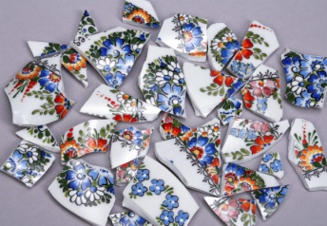
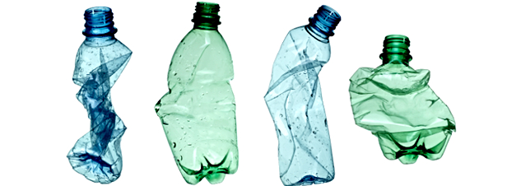
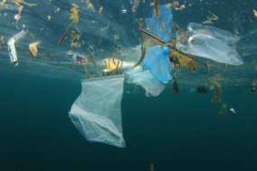
Common mistakes: don’t do it! - when you dispose of a plastic bottle, open i - don’t put old ceramics or mirrors to the container with glass - don’t put bio-waste in proper containers in plastic bags!

Slide 11
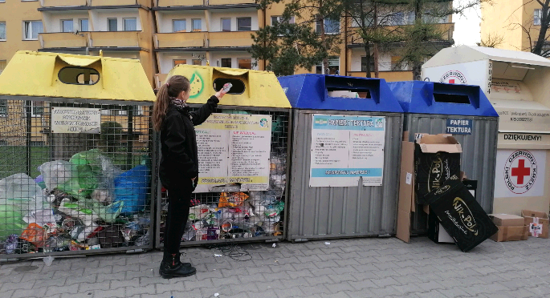
Thanks for watching

Slide 12
Bibliography:
https://gethome.pl/blog/segregacja-odpadow-co https://blog.doktortusz.pl/recykling-papieru-postarajmy-sie/-trzeba-wiedziec/
https://www.trinet.com.pl/segregacja-odpadow-jak-to-zrobic-prawidlowo/ https://eu.hsm.eu/pl/know-how/prasowanie/recykling-pet/mozliwosci-recyklingu-pet

