Slide 1
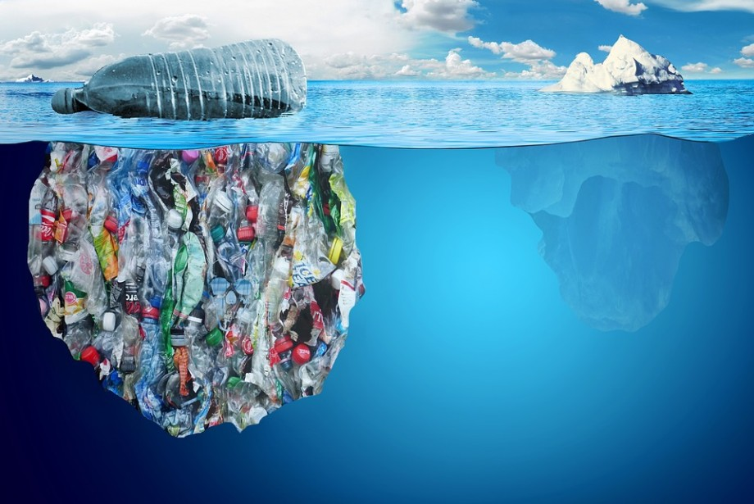
WASTE
the world's enemy

Slide 2
Some places are like paradise …
Do you dream of being there?
Remember!
Dreams come true!
Help your dreams
before others
destroy them!!!

Slide 3
BE A HERO
save the world

Slide 4
Waste
Waste is a huge problem of our times.
According to the World Bank report
What a Waste 2.0 :A Global Snapshot of Solid Waste Management to 2050
about 2 billion tons of solid waste is generated each year,
in 30 years we can expect the production of garbage at the level of 3.4 billion tons per year.
Responsible waste management
is one of the greatest challenges
of the 21st century.

Slide 5
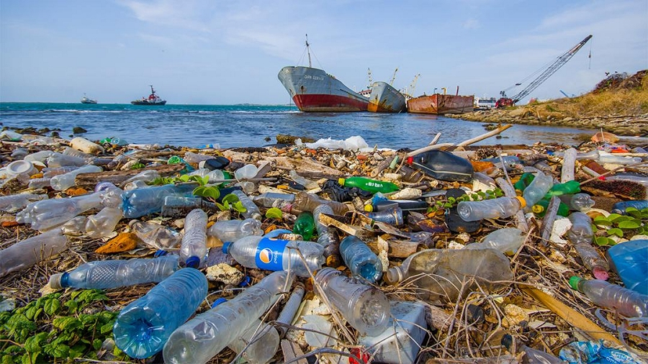
Waste management
Nature doesn’t produce waste !
Only humans produce waste that nature cannot recycle or it takes a very long time !
Modern innovations allow us to manage waste effectively,
efficiently and proper.
Please, think before you throw out rubbish!

Slide 6
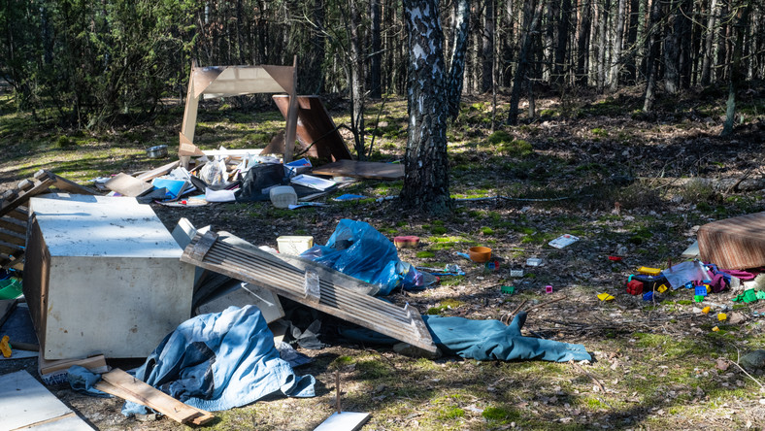
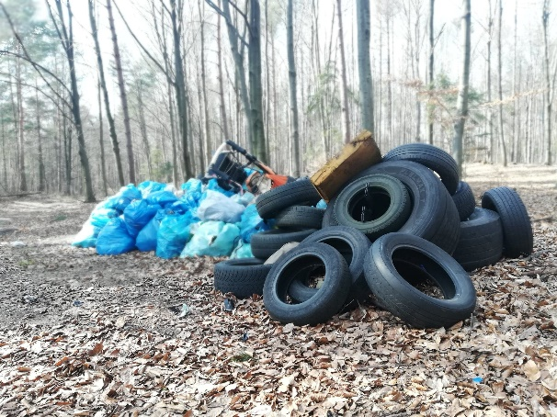
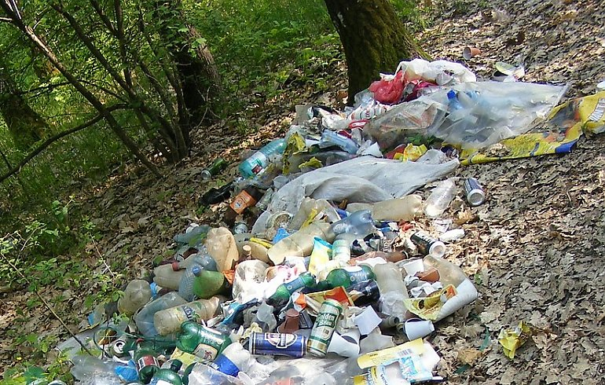
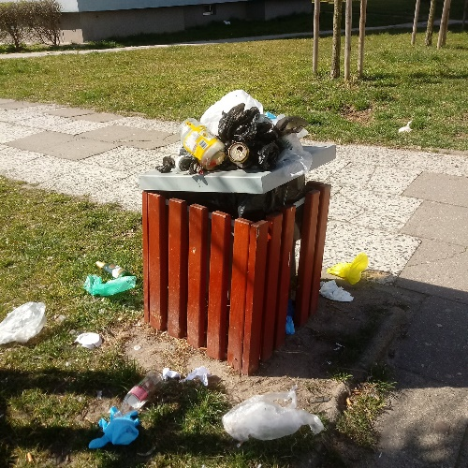
Municipal waste generation
Garbage is everywhere:
along the roads - thrown from cars,
used furniture, tyres, electronic equipment - are especially taken to forests or dumped in lakes, ponds,
chewing gum, sweets wrappers, bottles, cigarette butts, paper - they are on every pavement.
An average Pole produces about 300 kg of municipal waste per year.
That's 12 million tons per year nationwide.
Place waste in a designated area!

Slide 7
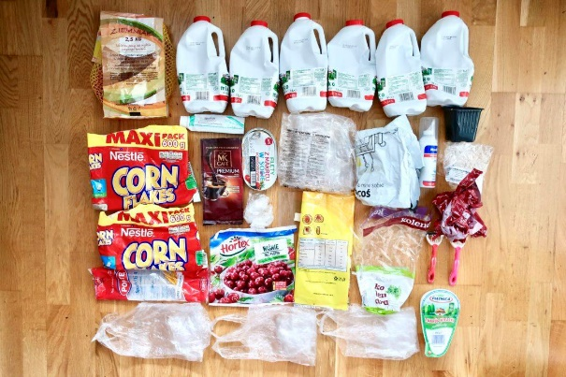
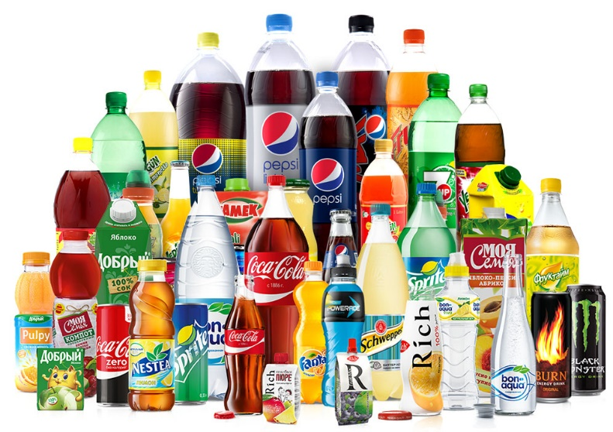
Packaging - a huge problem
Everything we buy is packed.
Often 1 product has several packs.
Packaging is advertising and therefore profit for the Producer.
Plastic bottles take several years to decompose - this produces chemical compounds that seep into the soil and water.
Pay attention to the labels on the packages - some packaging is reusable, recyclable, or biodegradable.
Remember!
If you choose environmentally unfriendly products, it means you accept them.

Slide 8
Waste disposal
RECYCLABLE
GREEN POINT
Proper waste disposal reduces the extraction of primary raw materials from the environment!
Proper waste disposal reduces the number of waste, saves water and energy needed to produce it!
COMPOSTABLE
REUSE

Slide 9
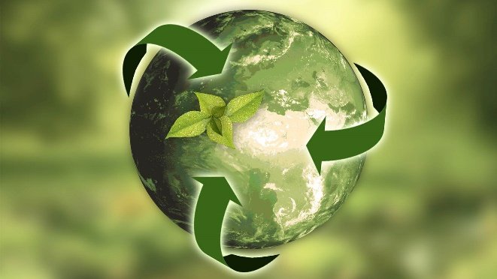
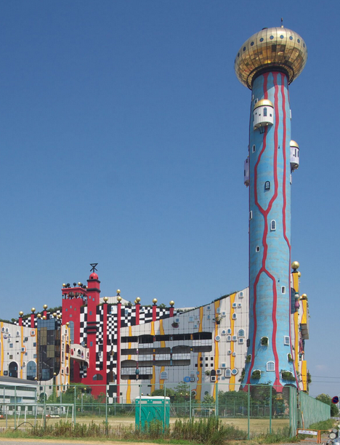
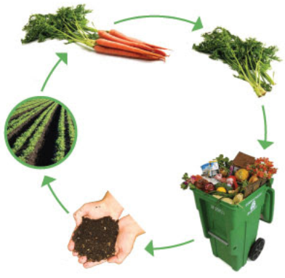
Recycling
products intended for reprocessing f.ex. waste paper -> toilet paper
plastic bottles -> foil, furniture, fleece
Reuse
products intended for reuse f.ex.
5 plastic bottles -> one sports T-shirt
plastic bags -> winter jacket filling
Modern waste incinerators
quick disposal method but very expensive; small amounts of harmful substances produced during combustion are retained and disposed of by special filters.
The ash is used f.ex. in the production of building materials.
Composting
use of organic waste, plant waste f.ex.
food scraps, grass cuttings, sawdust -> valuable nutrients for plants

Slide 10
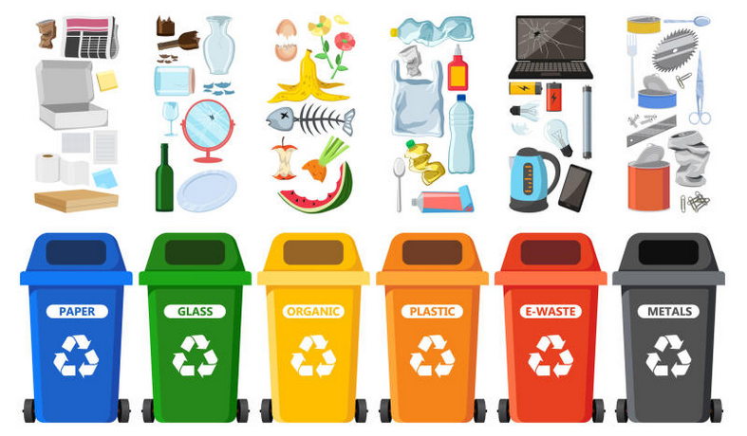
Waste segregation
Rubbish should be sorted - collect separately paper, plastic, glass, metals, organic waste and dangerous waste such as batteries, light bulbs and electronic equipment.
Thanks to selective collection, part of the waste will be used as secondary raw materials and part will be incinerated.
Waste segregation avoids landfill.

Slide 11
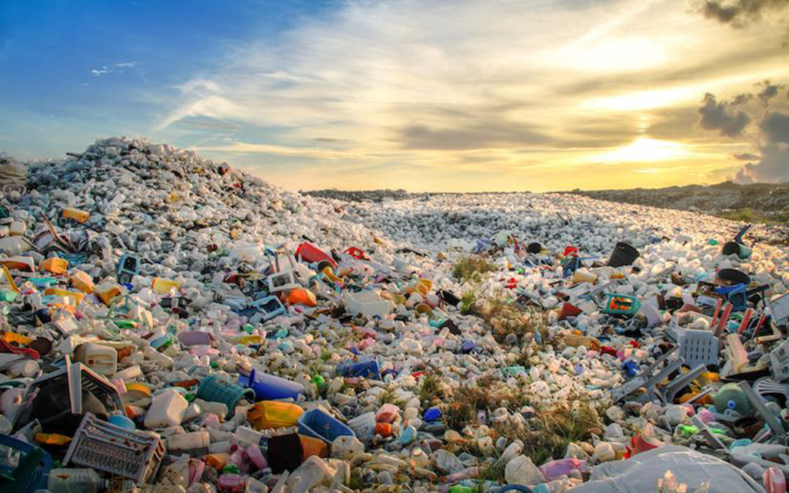
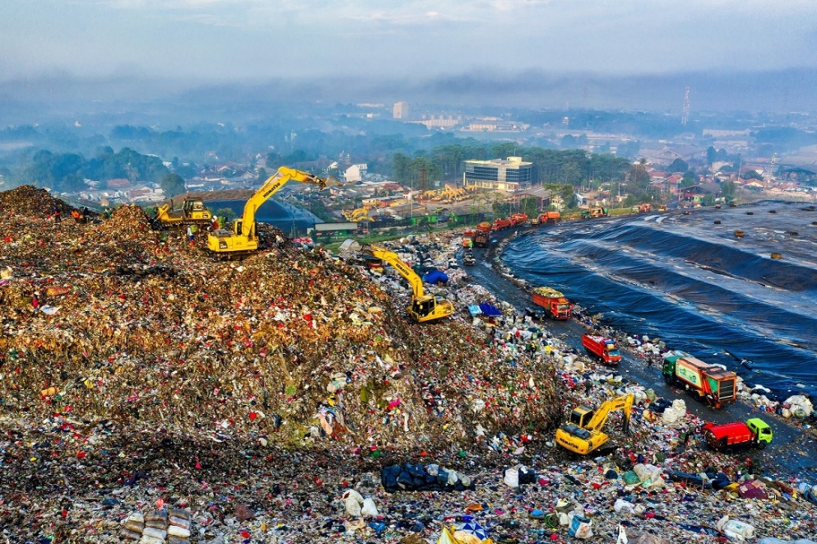
Waste storage
Landfills are a huge problem for the environment.
From landfills releases methane - a strong greenhouse gas contributing to climate change.
Landfills can also cause soil and water pollution.
Waste affects our health and quality of life:
air pollutants are released into the atmosphere,
inland water supplies are threatened,
plants are grown on polluted soil,
toxic substances enter the digestive systems of fish that finally end up on our plates.

Slide 12
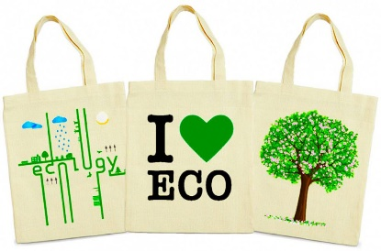
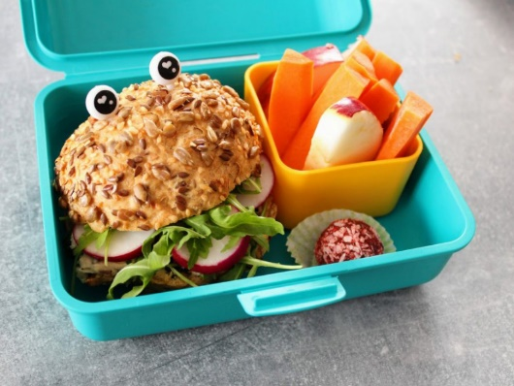
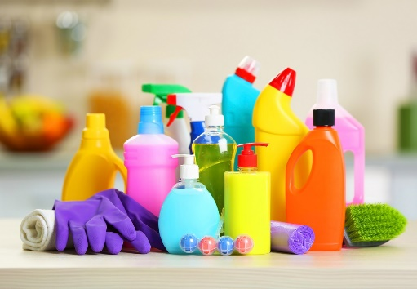
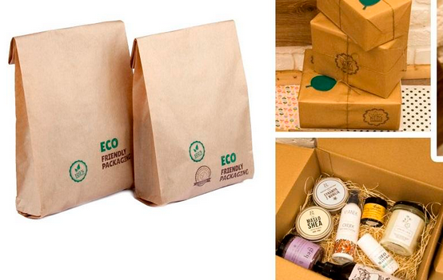
How to reduce waste ?
When going shopping, take durable bags,
give up plastic bags
Pack your second breakfast in a lunch box instead of a plastic bag
Choose products whose packaging is recyclable
Buy concentrated cleaning products and dilute them at home
Don’t buy water from the store, tap water is also good, you just need a filter
Choose products in economical, essential packaging

Slide 13
THANK YOU
Maja Cecot
Sources used:
https://odpady.net.pl/2020/09/23/smieci-to-ogromny-problem-naszych-czasow-jak-walczy-sie-z-nim-w-polsce-i-na-swiecie/
https://zpe.gov.pl/a/gospodarowanie-odpadami/DSKTcEUBm
https://www.forbes.pl/csr/10-produktow-o-ktorych-nie-wiedziales-ze-powstaja-z-odpadow/b5b4elr
http://zielonyklik.blogspot.com/2017/06/kompostowanie-odpadow.html
https://www.gios.gov.pl/pl/aktualnosci/318-odpady-problem-czy-zasob

