Slide 1
GREEN TRANSPORT
… and my eco family!!

Slide 2
GREEN TRANSPORT WHAT IS ECO AND WHAT IS NOT?
Let’s find out which means of transport are the most ecological.
How do we measure that?
Let’s see how do the single means of transport pollute?

Slide 3
GREEN TRANSPORTATION PYRAMID

Slide 4
GREEN TRANSPORTATION
PYRAMID

Slide 5
GREEN TRANSPORT WHAT IS ECO AND WHAT IS NOT?
What is the conclusion of this?
Be eco-friendly and use eco-friendly means of transport…
…whenever you can

Slide 6
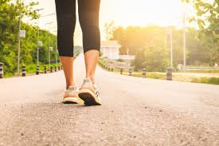
WALKING

Slide 7
WALKING
If You are healthy, your legs are the first and most reliable way of transport.
No exhaust fumes
No noise
No traffic jams
… and still it’s good for your health!
However, you won’t go too far☺

Slide 8
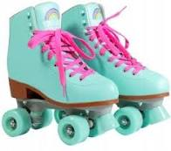
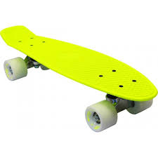
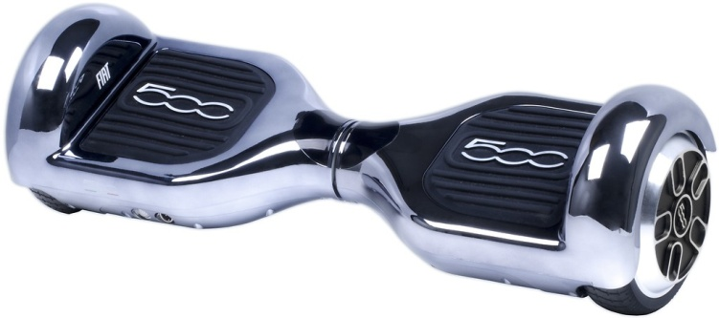
WHAT IF WE ARM OUR LEGS?
ROLLER SKATES
ELECTRIC SKATEBOARDS
SKATEBOARDS

Slide 9
WHAT IF WE ARM OUR LEGS?
Armed in rollers, skateboards, electric skateboards we are still ECO.
No exhaust fumes
No noise
No traffic jams
… and still it’s good for your health!
Now, you can go much further, but it’s a bit uncomfortable, because what you do with rollers on when you enter school?

Slide 10
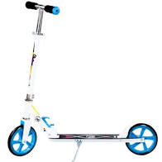
SO MAYBE A SCOOTER?
Using scooter or electric scooter, we are still ECO.
Besides the previous advantages, it’s handy.
But useful if you want to travel up to 10km.

Slide 11
HOW ABOUT A BIKE?

Slide 12
HOW ABOUT A BIKE?
OK, You want to be mobile, but don’t want to carry extra clothes and shoes.
How about a bike?
No exhaust fumes
No noise
No traffic jams
… and still it’s good for your health!
Now You can do even 100km per day… and it is not as difficult as you think.

Slide 13
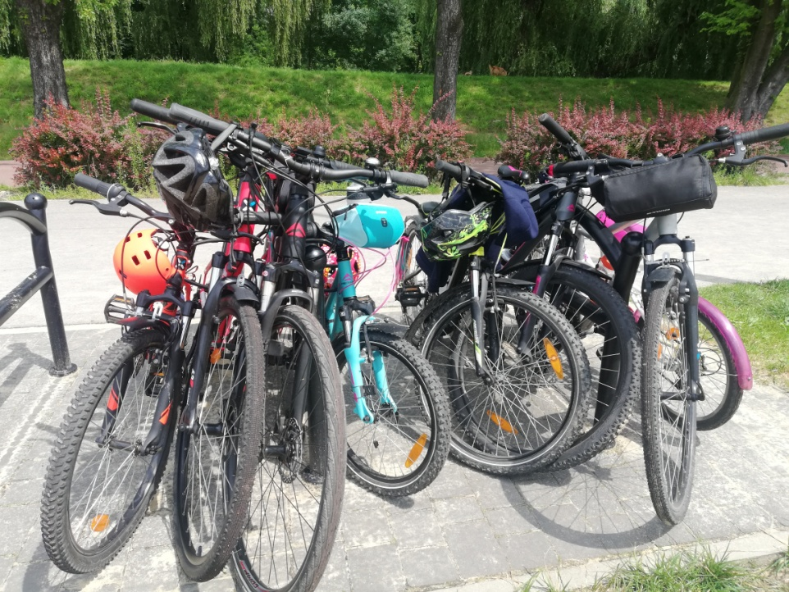
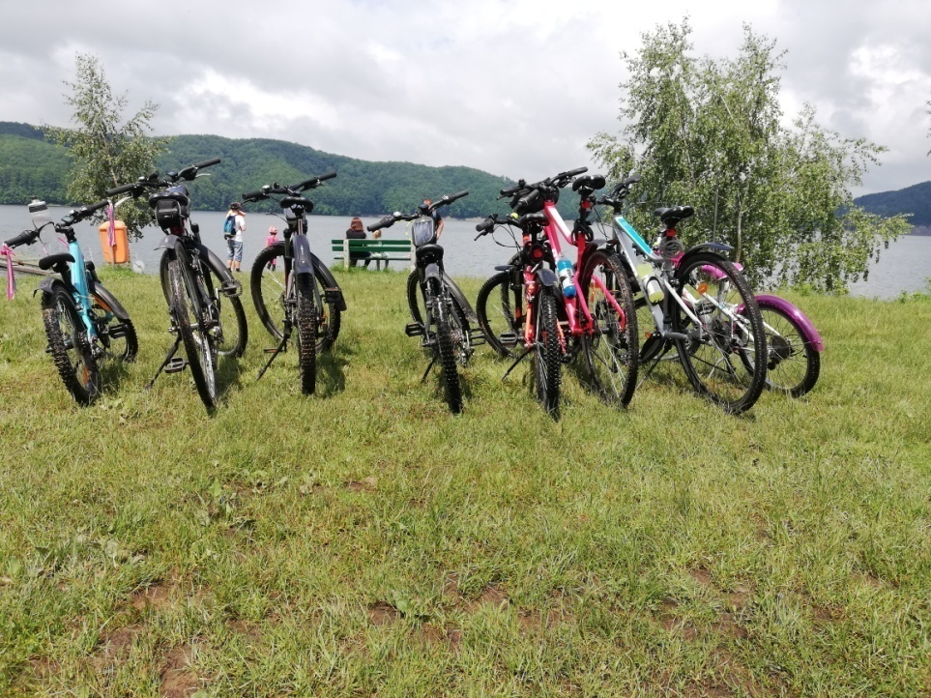
HOW ABOUT A BIKE?
My family chose bikes as a way of:
Commuting to work
Spending our free time
Spending our holidays

Slide 14
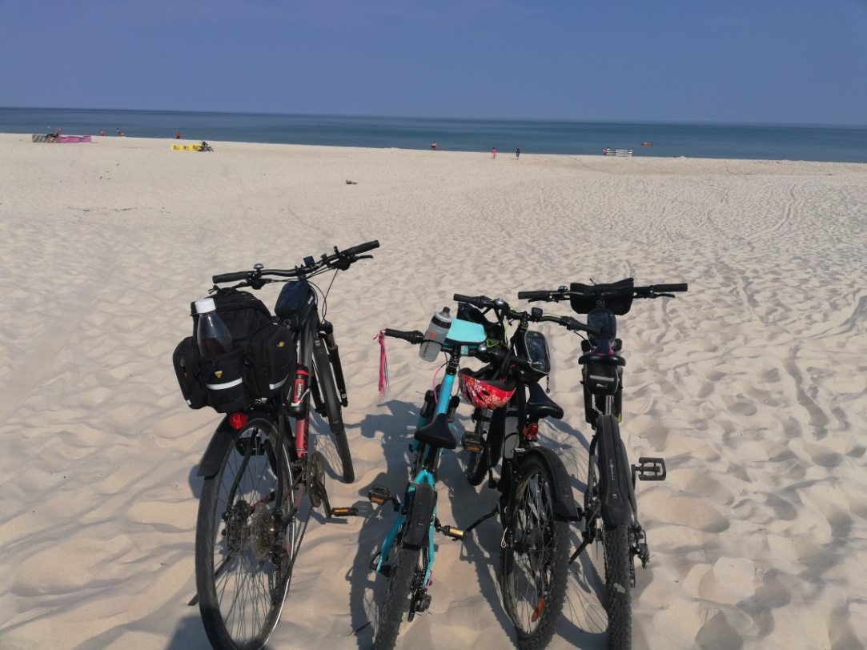
NOW WE CAN!!!
We can get on the bikes wherever we want.
Baltic Sea, August this year, one of the uncrowded beaches (they really exist!!)

Slide 15
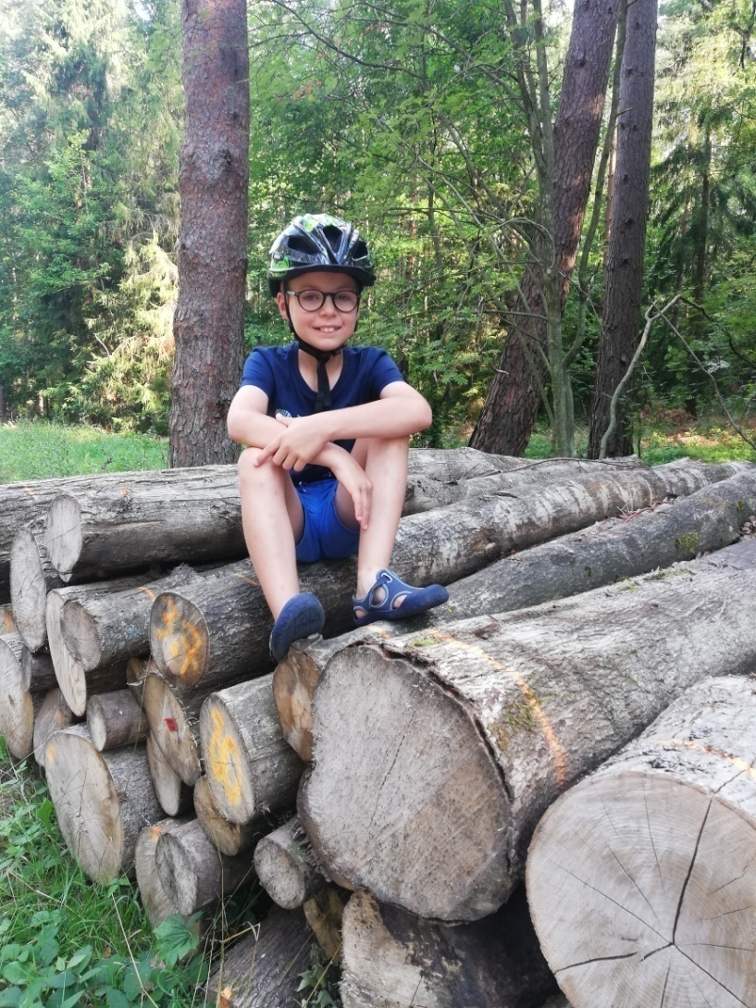
NOW WE CAN!!!
We can get on the bikes wherever we want.
Somewhere in the woods,
June- this year.

Slide 16
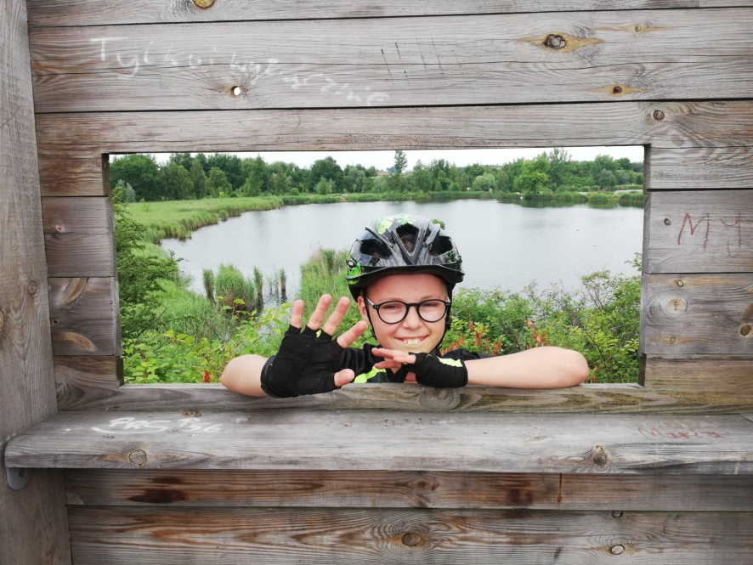
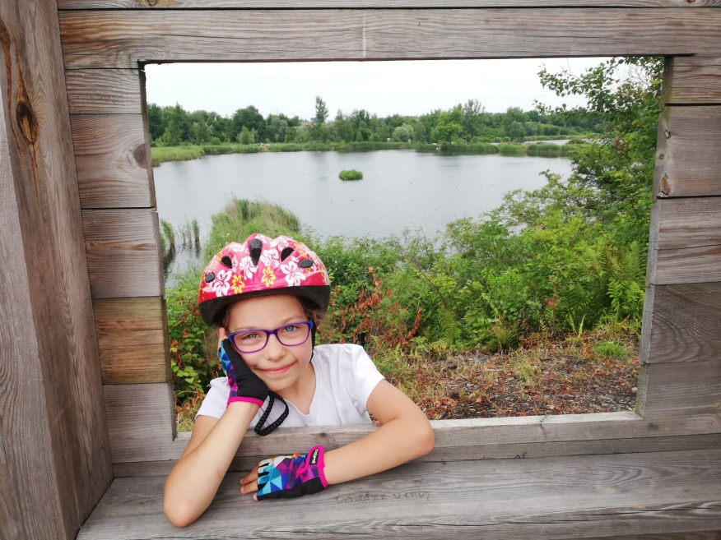
NOW WE CAN!!!
We can get on the bikes wherever we want.
One of the bicycle trips near home, Nature complex „Żabie Doły” / Frog Holes

Slide 17
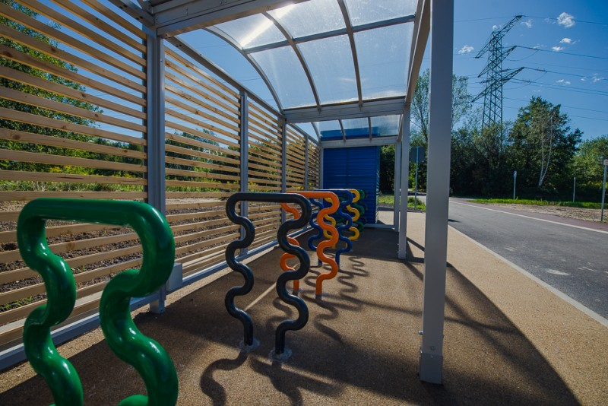
BIKE PATHS IN SIEMIANOWICE ŚLĄSKIE
Luckily, we have fine infrastructure in my neighborhood to ride a bike.
We have almost 30km of bicycle paths and few transfer centers in the city.

Slide 18
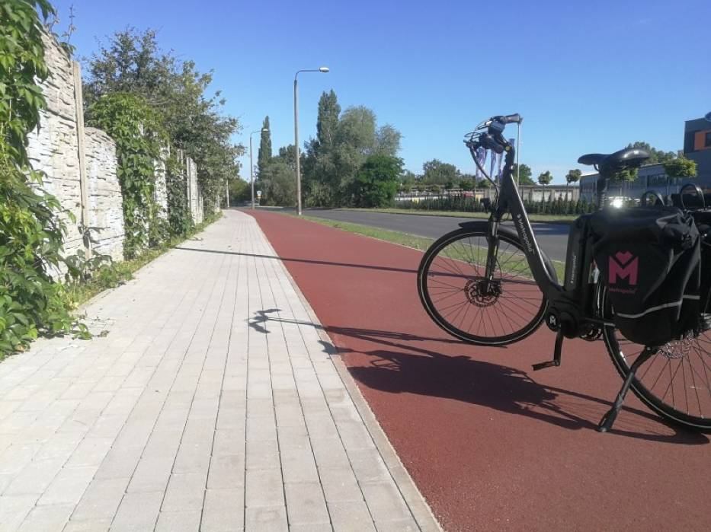
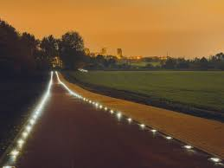
BIKE PATHS IN SIEMIANOWICE ŚLĄSKIE
…and it’s quite beautiful…
During a day
at night

Slide 19
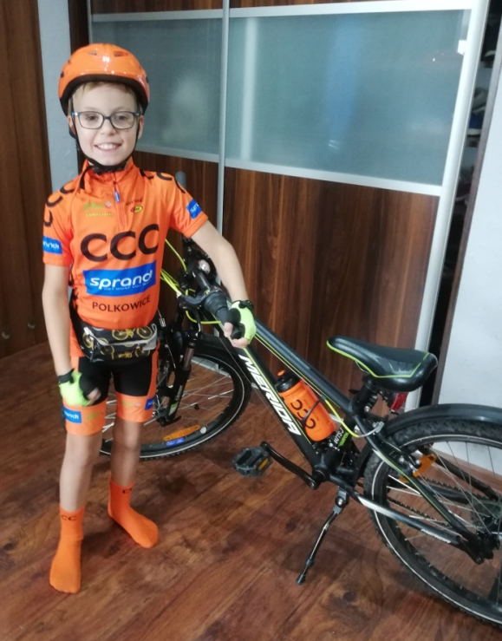
IT’S NOT ONLY WORDS….
It’s not only words, it’s kilometers travelled on two wheels this year!
KUBA 11y.- almost 900km
My sister HANIA 8y.- over 700km
My PARENTS together- over 2200km

Slide 21
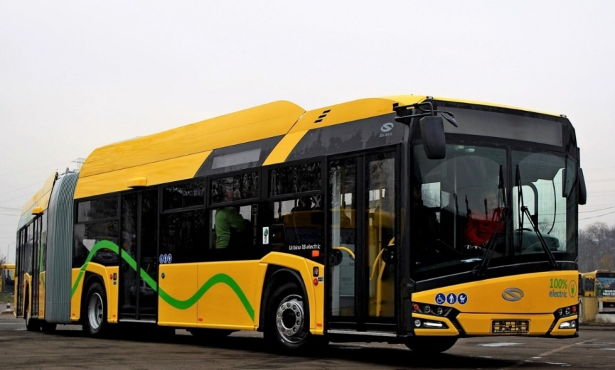
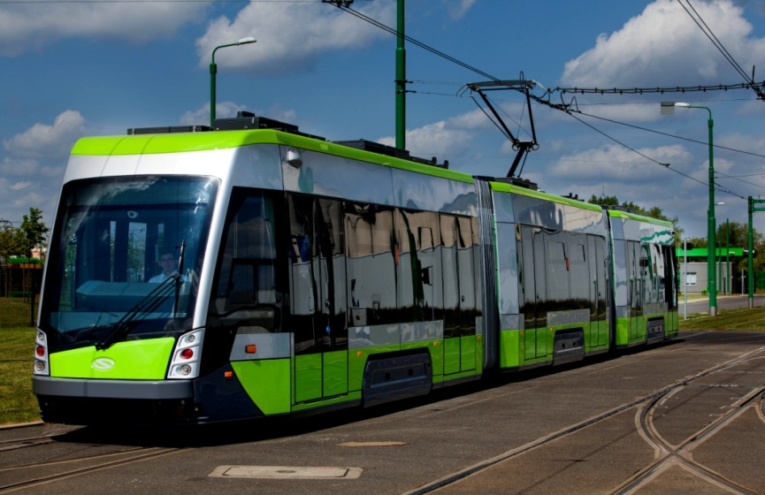
AFTER THE SEASON OR IN A BAD WEATHER
We can be ECO too…
…using Public Transport
ELECTRIC BUSES
TRAMS

Slide 22
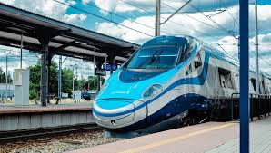
AFTER SEASON OR IN BAD WEATHER
TROLLEYBUSES
(only in few cities)
ELECTRIC TRAINS

Slide 23
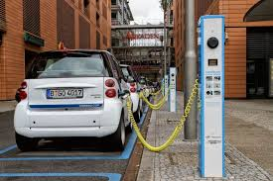
CAN WE HAVE ELECTRIC VEHICLE TOO?
Of course, we can own one of electric cars.
E-cars have some advantages:
No exhaust fumes, too
No noise
But you can get stuck in traffic jams
…and it doesn’t improve your health!

Slide 24
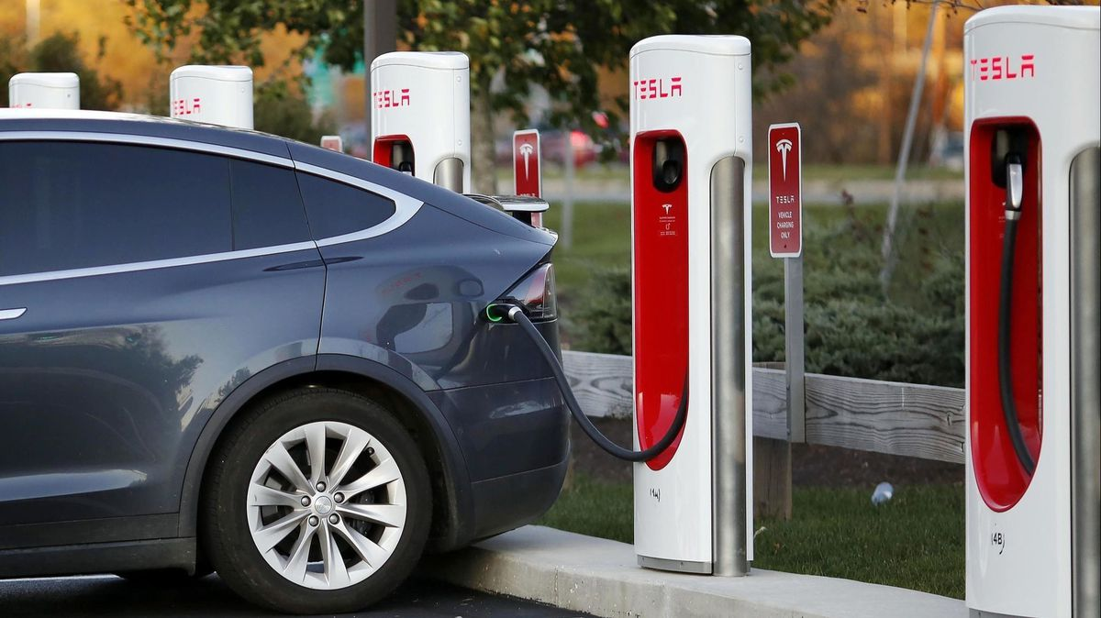
CAN WE HAVE ELECTRIC VEHICLE, TOO?
Car charging is still lasts a long time.
Faster chargers can „refuel” our car to 80% within 30 minutes.
Electic cars have small range comparing traditional cars.
It is 400km to 1000km.

Slide 25
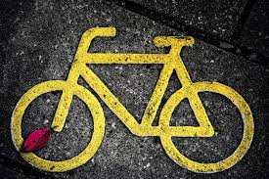
THANK YOU FOR YOUR ATTENTION
Jakub Bednorz, klasa VIa

