Slide 1
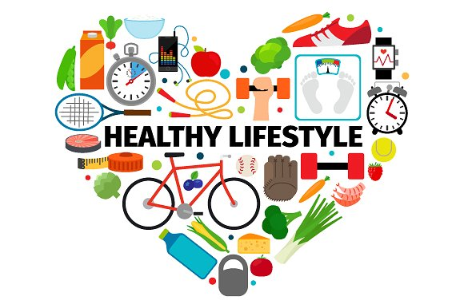
Healthy Lifestyle
among teenagers

Slide 2
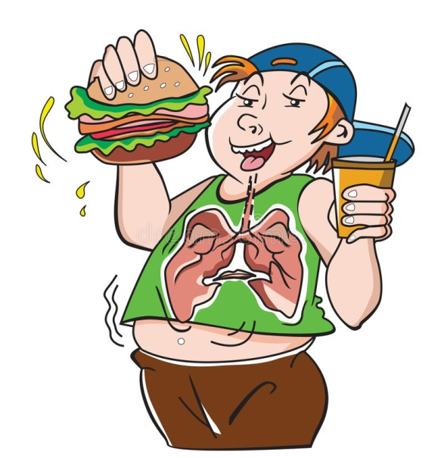
Teenagers' problem
In these times it is difficult to take care of a nice figure, a healthy lifestyle and proper nutrition, because there are many more processed, unhealthy and fast-food products on the market than 30 years ago.

Slide 3
Teenagers’ day vs healthy day
Teenangers’ Day | Healthy Day
after getting up immediately, they reach for chocolate, breakfast is eaten in a hurry, most often it is coffee, kebab and others for the second breakfast we eat a donut and drink coca-cola for lunch, they eat pizzas and drink energy drinks for supper they eat sausages with cheese and ketchup, drink sprite | after getting out of bed we do morning gymnastics, eat slowly, chew healthy breakfast, for example yogurt, porridge, smoothie for the second breakfast we eat a wholemeal roll with lettuce, tomato and ham, and drink freshly squeezed orange juice for lunch, we eat turkey steamed with broccoli and rice for supper, we eat a cauliflower salad of couscous and drink green tea without sugar

Slide 4
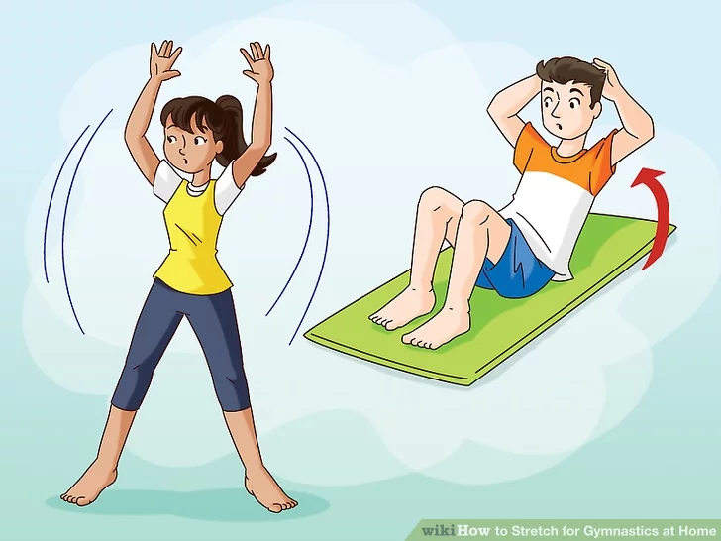
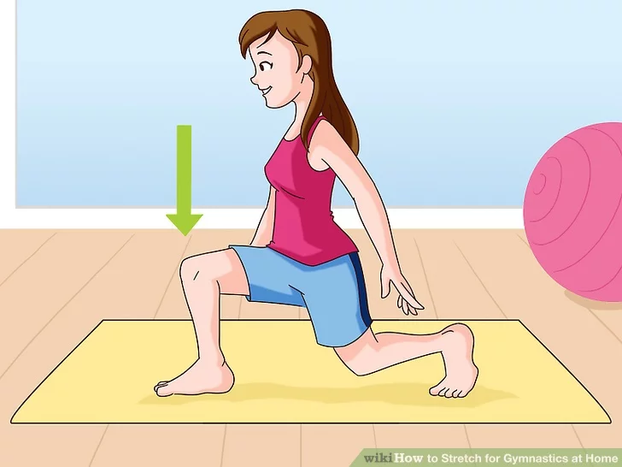
Morning Gymnastics
Warm up Right and Left Splits
Do a lunge

Slide 5
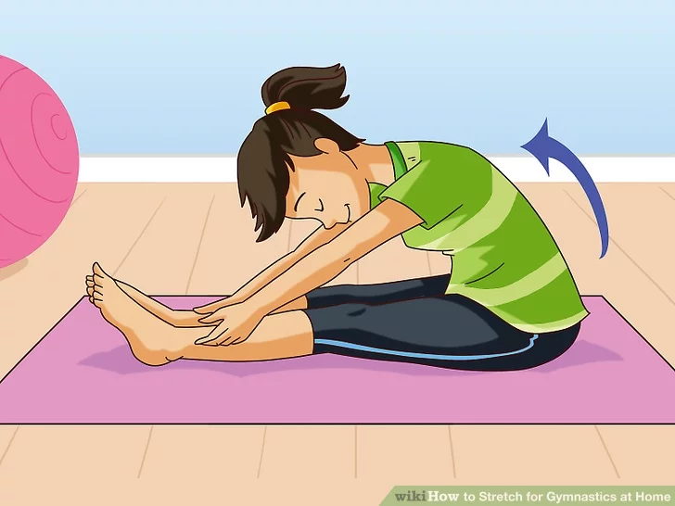
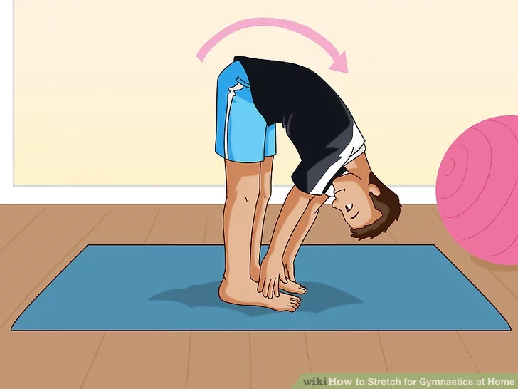
Morning Gymnastics
Go "nose to knee" Stand up and touch your toes.

Slide 6
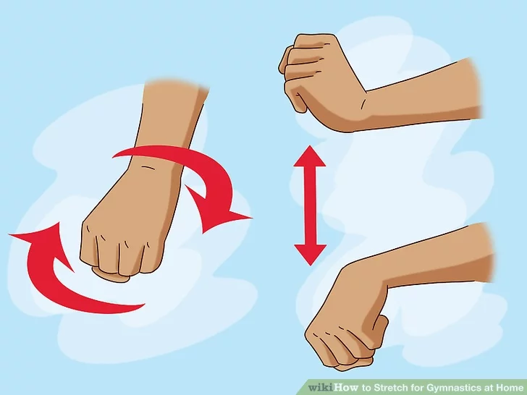
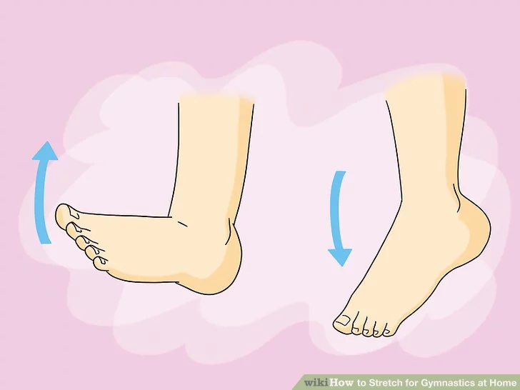
Morning Gymnastics
Stretching your wrists Stretching your ankles

Slide 7
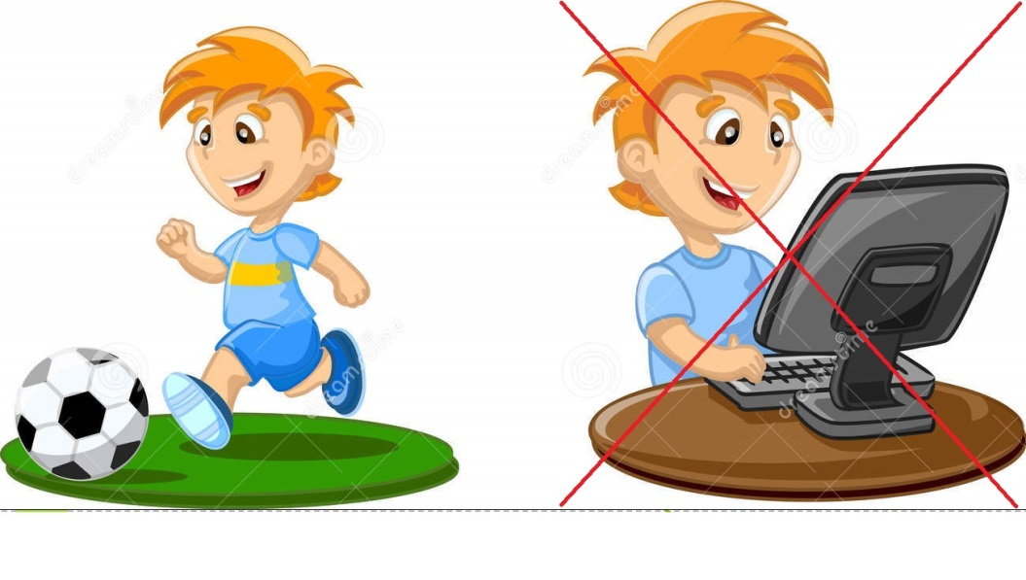
Teenagers’ Afternoon
sits in front of the TV with popcorn
plays games on the computer
Eats
he doesn’t do his homework

Slide 8
Healthy Foods
Vegetables
Fruit
Yogurt
Salads
Soups
Meat

Slide 9
What does it mean to "be healthy"?
The most popular definition explaining that health is simply the lack of disease has become outdated. The eminent Polish theoretician of social medicine, Marcin Kacprzak, said: "health is not only a lack of disease or ailments, but also well-being and the degree of biological, mental and social adaptation that is available to a given individual in the most favorable conditions."

Slide 10
10 principles of a healthy lifestyle
Start the day with a filling breakfast
Eat regularly
Spice up!
Avoid high-processed and confectionery products
Drink the right amount of water
Enter physical activity
Take care of relaxation
Work on your self-esteem
Spend time actively
Make changes in small steps

Slide 11
To be healthy, do not use drugs, cigarettes and alcohol !!!

Slide 12
Prepared by Anita Grześkowiak and Laura Mendrala. We count on good grades. Thank you for watching!

